Slide 1
West Midlands branch
AGM
17th November 2020

Slide 2
Welcome

Slide 3
RSB AGM
What is our Annual General Meeting (AGM)?
This is a meeting of the membership required by RSB bylaws, regulations and Royal Charter where members conduct business.
All RSB branches are required to hold an AGM each financial year (1st October –30th September).
In practice the AGM can be a very short session held before or after a regular branch event.

Slide 4
Introductions
Current West Midlands Committee Members
Chair: Dr Sue Howarth CBiol FRSB
Treasurer: Lesley Payne CBiol MRSB
External Communication Secretary: Lesley Payne CBiol MRSB
Meetings Secretary: Amelia Lakin AMRSB
Student Engagement Coordinator: Dr Phillip Young FRSB
Events Coordinators: Norma Broadbridge MBE FRSB,
Dr Caroline Day CBiol FRSB, Dr Daniel Franklin MRSB, Ben Glover,
Dr Jill Johnson MRSB, Prof. Luisa Orsini, Dr Sarah Williams MRSB

Slide 5


RSB Ambassadors, West Midlands
Dr Sarah Williams Dr Ashok Patel

Slide 6
Agenda
1.Introduction and welcome
2.Attendance and apologies for absence
3.Minutes of the AGM of 05.11.19
4.Review of committee roles
5.Election of Committee for 2020/21
6.Branch Annual Report, including events 2019/20; questions
7.Branch Treasurer’s Report; questions
8.Future events
9. Prof. Nigel Brown (5 min)
AOB

Slide 7
Attendance List
10 WM members needed for quorum

Slide 8
Apologies

Slide 9
Agenda
1.Introduction and welcome
2.Attendance and apologies for absence
3.Minutes of the AGM of 05.11.19
4.Review of committee roles
5.Election of Committee for 2020/21
6.Branch Annual Report, including events 2019/20; questions
7.Branch Treasurer’s Report; questions
8.Future events
9. Prof. Nigel Brown (5 min)
AOB

Slide 10
Minutes of the 2019 AGM
Royal Society of Biology West Midlands Branch
Annual General Meeting 05.11.2019 18.40 – 19.15
Room BSR1, Gibbet Hill Campus, University of Warwick CV4 7AL
Recorded by Sue Howarth with help from Norma Broadbridge.
Draft Minutes
The purpose of the AGM was explained and members and guests welcomed.
a. Attendees: Norma Broadbridge, David Elsy, Daniel Franklin, Ben Glover, Sue Howarth, , Annora Johnson, Richard Johnson (non-member), Kevin Moffat (from 18.55), Harriet Nolan, Lesley Payne, John Payne (non-member), Robert Savage, Phil Young.
b. Apologies: Jess Andrews, Carl Bethell, Caroline Day, Amelia Lakin, Jill Johnson
Minutes of the AGM of 21.11.2018 were circulated and approved. Proposer: N. Broadbridge. Seconder: L. Payne
Review of committee roles: this was discussed and agreed that the committee could be flexible over changes in roles over the coming year. It would be helpful to have a Vice Chair.
Election of Committee for 2019/20 – no new names had been submitted and no-one in the room wanted to put their names forward apart from the existing committee. All committee members apart from Elisha Zadok had agreed to stay on the committee in their current roles and this was voted on. Proposer: P. Young; Seconder: A. Johnson. Those members who had been co-opted (D. Franklin, B. Glover and A. Lakin) were now properly elected members of the committee. It was agreed to try to contact Elisha again to check what he wants to do.
The Branch Annual Report including events 2018/19 was presented. The PowerPoint is attached to these Minutes. No questions.

Slide 11
Minutes of the 2019 AGM
The Branch Treasurer’s Report was presented; questions included whether this year’s events were more in number than last years; some of the detail was clarified about how funds are ‘carried over’. The report was accepted. Proposer: N. Broadbridge; Seconder: P. Young.
Future events were discussed. The distance from the train station to BCU for the Christmas Social event was discussed and this need clarifying on the booking information. Support was given for going forward with a forestry talk and visit. Additional future events were discussed including using Tudor Grange School, Solihull, as a venue for talks.
There was no AOB
Thanks were given to Warwick University for hosting the event and Dr Phil Young for organising rooms, speaker and refreshments.
The AGM was followed by an adjournment to the central campus for light refreshments in the Oculus atrium and a talk at 20.00, in Lecture Theatre 3 given by Professor Kevin Moffat of Warwick University, titled “Drosophila - Not just a fly, rather a genetic hero" which paid homage to 2019 being the Year of the Fly. A good number of undergraduate students, non-members and RSB members joined us for the talk.
Branch Report 2018-2019 can be found on the separate PowerPoint

Slide 12
Agenda
1.Introduction and welcome
2.Attendance and apologies for absence
3.Minutes of the AGM of 05.11.19
4.Review of committee roles
5.Election of Committee for 2020/21
6.Branch Annual Report, including events 2019/20; questions
7.Branch Treasurer’s Report; questions
8.Future events
9. Prof. Nigel Brown (5 min)
AOB

Slide 13
Review of Committee Roles
Chair
Vice Chair
Treasurer
External Communication Secretary
Meetings Secretary
Student Engagement Coordinator
Events Coordinators 4 vacancies

Slide 14
Election of Committee 2020-2021
Chair: Dr Jill Johnson MRSB
Vice Chair: Dr Sue Howarth CBiol FRSB
Treasurer: Lesley Payne CBiol MRSB
External Communication Secretary: Lesley Payne CBiol MRSB
Meetings Secretary: Amelia Lakin AMRSB
Student Engagement Coordinator: Dr Phillip Young FRSB
Events Coordinators:
Dr Caroline Day CBiol FRSB; Dr Patricia Estaban; Dr Daniel Franklin MRSB
Ben Glover; Laura Guest
Honorary Consultant: Norma Broadbridge MBE FRSB

Slide 15
Voting
Current committee members staying in same role
Current committee members changing role
Nomination forms received for new committee members

Slide 16
Voting via Zoom
Proposer; seconder.
Have a blanket approval of resolutions or election of committee members
Attendees have the opportunity to voice any objections via
Zoom chat or the raise hand function.

Slide 17
Election of Committee 2020-2021
Chair: Dr Jill Johnson MRSB
Vice Chair: Dr Sue Howarth CBiol FRSB
Treasurer: Lesley Payne CBiol MRSB
External Communication Secretary: Lesley Payne CBiol MRSB
Meetings Secretary: Amelia Lakin AMRSB
Student Engagement Coordinator: Dr Phillip Young FRSB
Events Coordinators:
Dr Caroline Day CBiol FRSB; Dr Patricia Estaban; Dr Daniel Franklin MRSB
Ben Glover; Laura Guest
Honorary Consultant: Norma Broadbridge MBE FRSB

Slide 18

Laura and Patricia
New West Midlands branch committee members

Slide 19

Dr Luisa Orsini and Dr Sarah Williams
Committee members 2019- 2020

Slide 20
Agenda
1.Introduction and welcome
2.Attendance and apologies for absence
3.Minutes of the AGM of 05.11.19
4.Review of committee roles
5.Election of Committee for 2020/21
6.Branch Annual Report, including events 2019/20; questions
7.Branch Treasurer’s Report; questions
8.Future events
9. Prof. Nigel Brown (5 min)
AOB

Slide 21
Branch Annual Report – by numbers
1 Charter lecture (1)

Slide 22
Branch Annual Report – by numbers
1 Charter lecture (1)
2 new committee members (3)

Slide 23
Branch Annual Report – by numbers
1 Charter lecture (1)
2 new committee members (3)
3 non-online talks (3)

Slide 24
Branch Annual Report – by numbers
1 Charter lecture (1)
2 new committee members (3)
3 non-online talks (3)
4 venues (9)

Slide 25
Branch Annual Report – by numbers
1 Charter lecture (1)
2 new committee members (3)
3 non-online talks (3)
4 venues (9)
5 committee meetings (4)

Slide 26
Branch Annual Report – by numbers
1 Charter lecture (1)
2 new committee members (3)
3 non-online talks (3)
4 venues (9)
5 committee meetings (4)
13 events (13)

Slide 27
Branch Annual Report – by numbers
1 Charter lecture (1)
2 new committee members (3)
3 non-online talks (3)
4 venues (9)
5 committee meetings (4)
13 events (13)
656 Twitter followers @RSBWestMids (490)

Slide 28
Branch Annual Report – by numbers
1 Charter lecture (1)
2 new committee members (3)
3 non-online talks (3)
4 venues (9)
5 committee meetings (4)
13 events (13)
656 Twitter followers @RSBWestMids (490)
847 branch members (Jan 2020) (914)

Slide 29
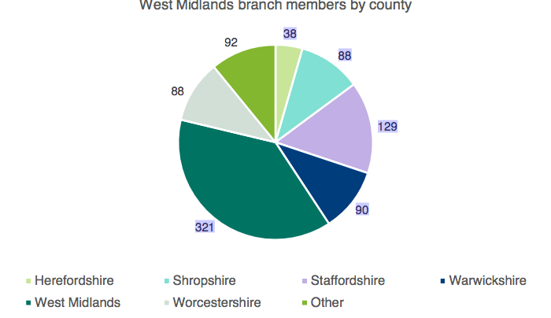
Jan 2020

Slide 30
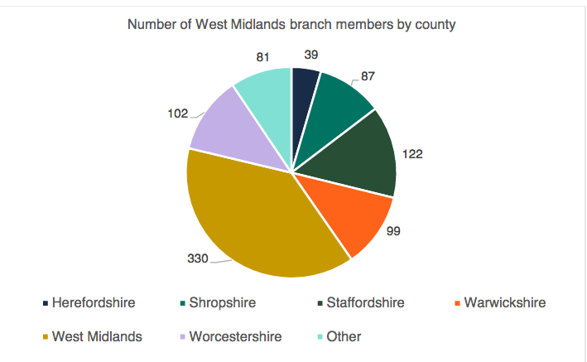
Jan 2019

Slide 31
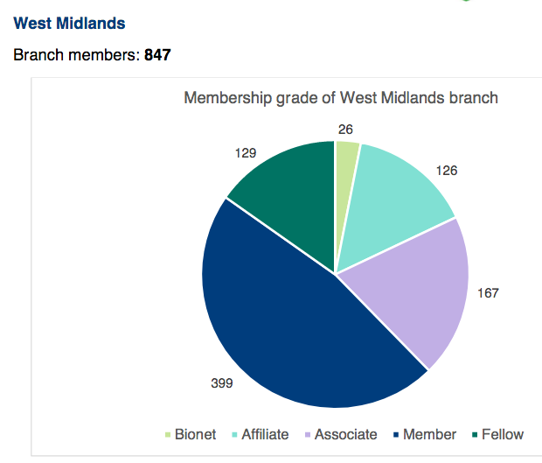
Jan 2020

Slide 32
Events 2019-2020

Slide 33
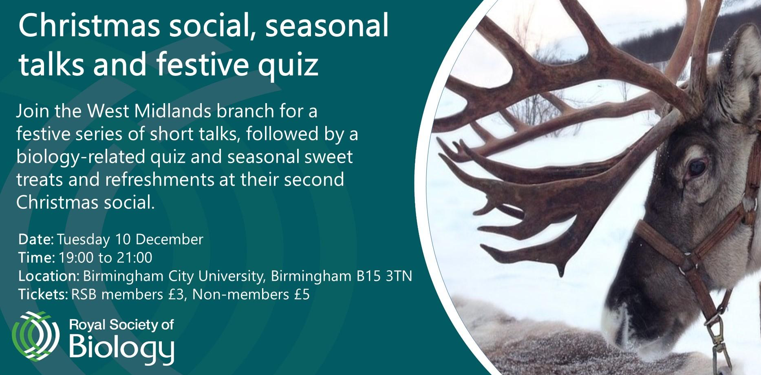
December 2019

Slide 34
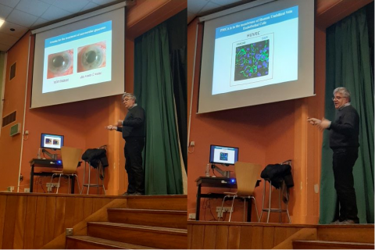
January 2020
Talk on Blood Vessels
Tudor Grange School, Solihull

Slide 35
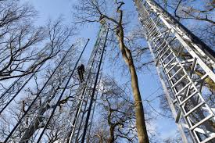
February 2020
Forestry Talk
The new Institute of Forest Research,
BiFoR
University of Birmingham

Slide 36
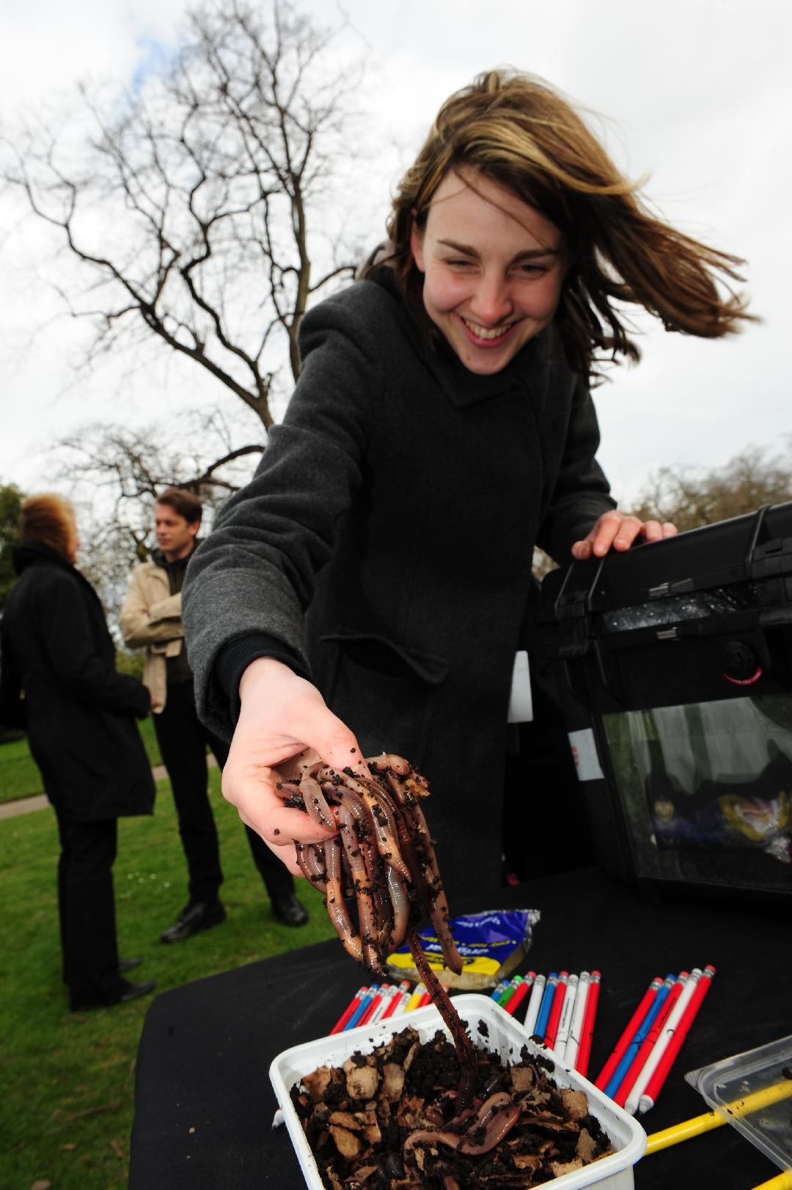
February 2020
Darwin Festival,
Shrewsbury
Darwin’s Worms
Emma Sherlock
NHM

Slide 37

COVID-19 Talk + Q&A
May
2020
RSB Twitter Take-over
Daniel Franklin

Slide 38
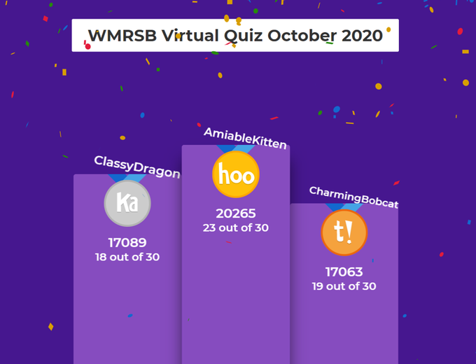
May, June, July, August, Sept, Oct, Nov
Virtual Quizzes
Jill & Ben

Slide 39


Slide 40


Slide 41

Charter Lecture: 07 Oct 2020

Slide 42

November Virtual Quiz

Slide 43
Online Committee Meetings
April, June, September

Slide 44

November AGM & Hedgehog Talk

Slide 45
Questions

Slide 46
Agenda
1.Introduction and welcome
2.Attendance and apologies for absence
3.Minutes of the AGM of 05.11.19
4.Review of committee roles
5.Election of Committee for 2020/21
6.Branch Annual Report, including events 2019/20; questions
7.Branch Treasurer’s Report; questions
8.Future events
9. Prof. Nigel Brown (5 min)
AOB

Slide 47
Branch Treasurer’s Report

Slide 48
Questions

Slide 49
Agenda
1.Introduction and welcome
2.Attendance and apologies for absence
3.Minutes of the AGM of 05.11.19
4.Review of committee roles
5.Election of Committee for 2020/21
6.Branch Annual Report, including events 2019/20; questions
7.Branch Treasurer’s Report; questions
8.Future events
9. Prof. Nigel Brown (5 min)
AOB

Slide 50
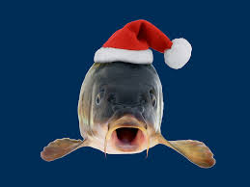
December Quiz. No. 8 in our series

Slide 51

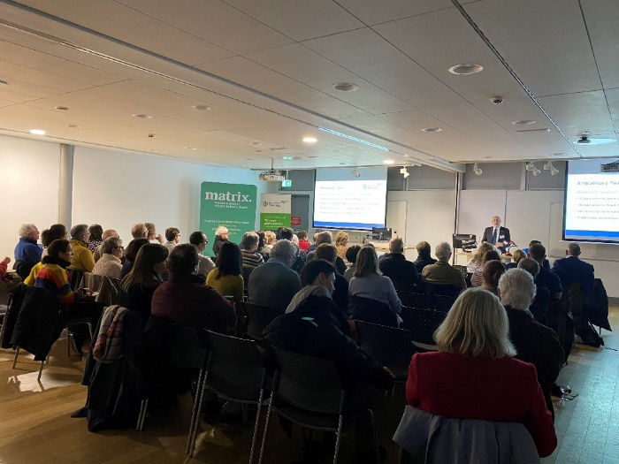
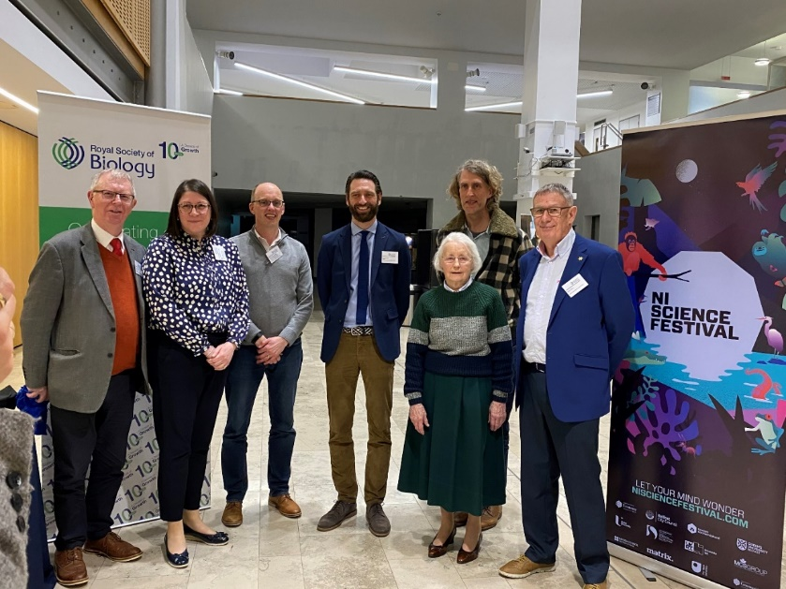
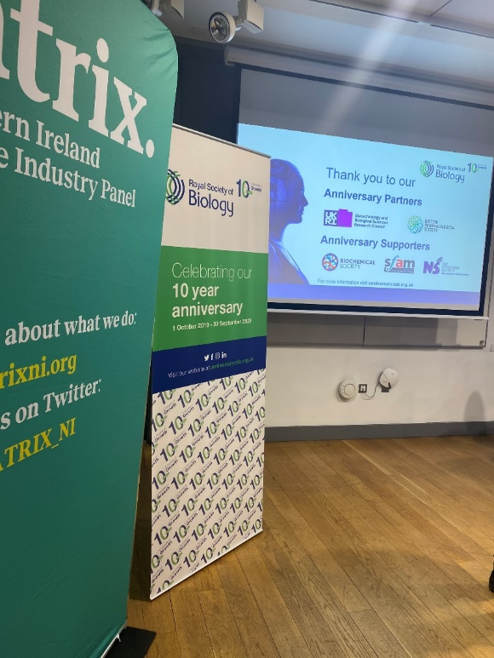
Pioneers of Biology series
Frank Pantridge – Developed the portable defibrillator
19th February in Northern Ireland
Notes:
-Overview of when the events were/are
-Success of the first in the series (Northern Ireland)
-Upcoming (Yorkshire and Wessex but more TBC)

Slide 52

Pioneers of Biology series
Maurice Wilkins
Produced the first clear X-ray images of DNA
Shared the 1962 Nobel Prize for Physiology with Watson & Crick
Speaker: Sir Paul Nurse
Venue: University of Birmingham
Notes:
-Overview of when the events were/are
-Success of the first in the series (Northern Ireland)
-Upcoming (Yorkshire and Wessex but more TBC)

Slide 53
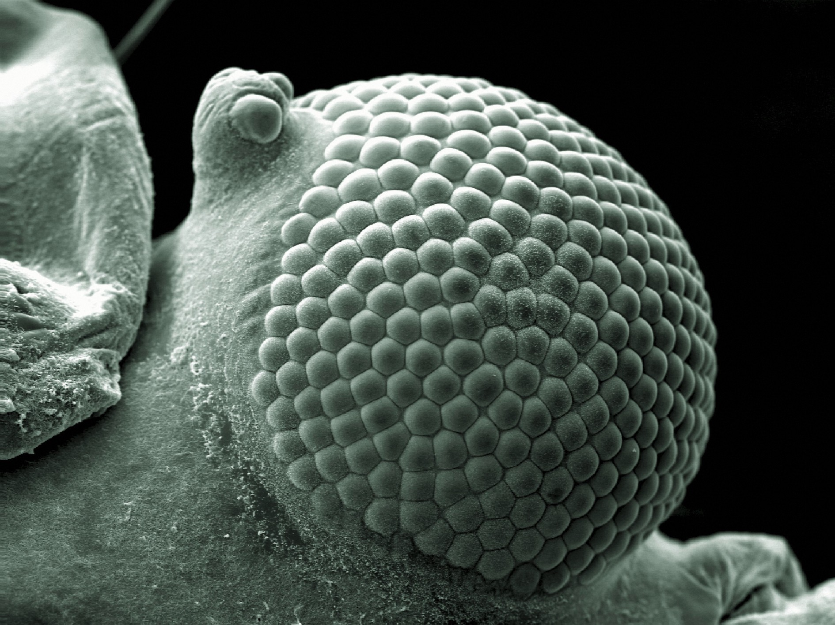
Photography Competition

Slide 54
Photography Competition
Eye of a greenfly
https://medium.com/vantage/biology-s-most-stunning-and-strange-images-of-the-year-7eaa55a03a3b

Slide 55
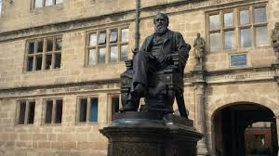
Online Darwin Festival Feb 2021
Search is on for speaker

Slide 56
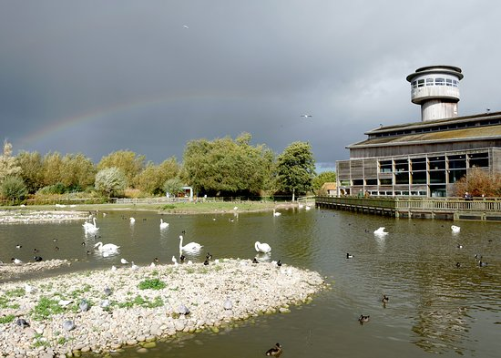
Visit to Slimbridge, WWT
Autumn/Winter 2021
Possibly in association with the Western branch

Slide 57
Visit to UoB new Institute of Forest Research
Talk on Soil Science – University of Wolverhampton
Visit to the Medical Museum, Worcester

Slide 58
Agenda
1.Introduction and welcome
2.Attendance and apologies for absence
3.Minutes of the AGM of 05.11.19
4.Review of committee roles
5.Election of Committee for 2020/21
6.Branch Annual Report, including events 2019/20; questions
7.Branch Treasurer’s Report; questions
8.Future events
9. Prof. Nigel Brown (5 min)
AOB

Slide 59
AOB

Slide 60

Stay in touch
Twitter: @RSBWestMids
Instagram: https://www.instagram.com/rsb_west_midlands/
Website: https://www.rsb.org.uk/regional-activity/england/west-midlands
Email: westmidlands@rsb.org.uk
To all attendees this evening.
Most of the AGM material will be available online soon.

