Slide 1
Join a branch committee by becoming an RSB member
Help organise and support events and activity in your region
Gain valuable experience for CPD and professional development
Work with other members and meet interesting individuals and organisations
Network with other biologists

Slide 2
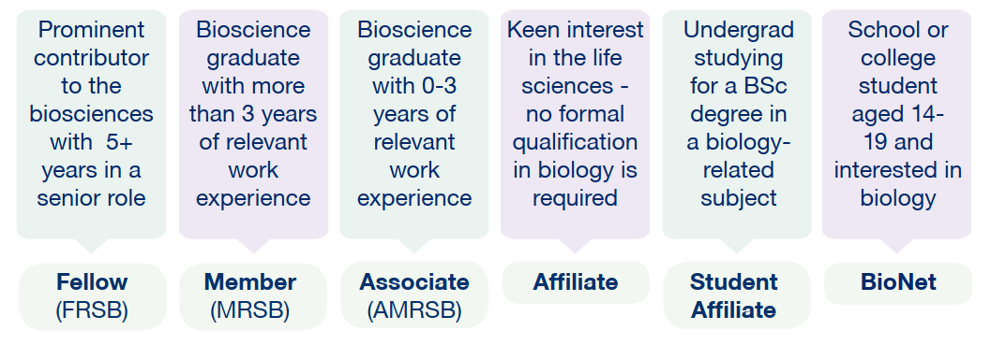
Grades of RSB membership
Notes:
THESE ARE THE DIFFERENT GRADES OF MEMBERSHIP
Affiliate: Anyone with an interest in the life sciences
Student Affiliate: undergraduate student studying a biology-related subject
Associate (AMRSB): Awarded a degree containing at least 50% biology in the final two years of study. Also a *CPD route
Member (MRSB): Graduate in a bioscience subject with at least three years’ postgrad experience. Also a *CPD route
Fellowship (FRSB): Prominent contribution to the advancement of the biological sciences, at least five years’ experience in a position of senior responsibility
<*CPD route recognises that someone can obtain an equivalent level of experience through working in the life sciences.
You can use the Membership benefits spreadsheet for more indepth information>
DISCOUNTS are available if you are a Recent Graduate (<2 years since finishing undergraduate degree), a Masters or Phd Student, in Unpaid Employment, Retired or on a Career Break, or a member of one of our Member Organisations.

Slide 3
Join today
We offer membership to anyone who is passionate about biology, students and professionals
Why not join the network today and support your local region:
www.rsb.org.uk/join
membership@rsb.org.uk

