Slide 1
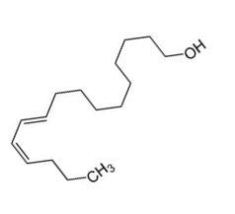
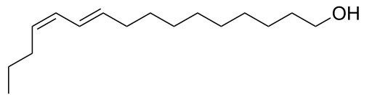
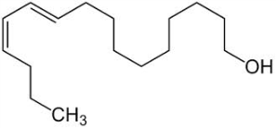
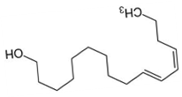

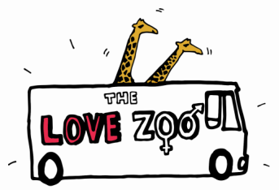


What
are
Phero
mones?
Pheromones are natural chemicals produced by some animals that trigger a response in members of the same species.
The response is often a change in behaviour but can also be a change in the animal’s physiology (the way its body is working).
The males Pheromones act like hormones, but outside the body, and affect the behaviour of other individuals of the same species rather than the individual producing them.
Types of pheromones
Food trail pheromones
Alarm pheromones
Sex pheromones

Slide 2
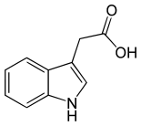
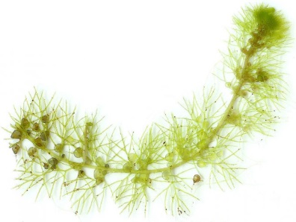
What
are
Horm
ones?
Hormones are chemical substances that act like messenger molecules in the body of humans and other animals.
After being made in one part of the body, they travel to other parts of the body where they help control how cells and organs do their work.
Plants have hormones too – they are called phytohormones
Hormones are produced by special organs called glands and carried to a different target organ in the blood.

Slide 3
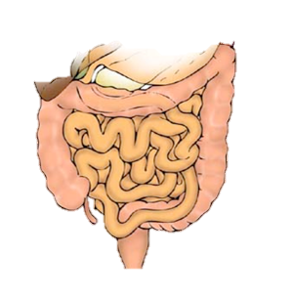
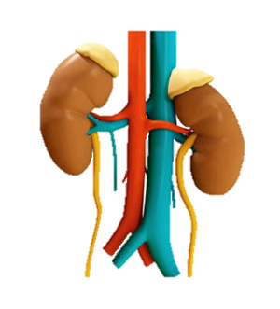
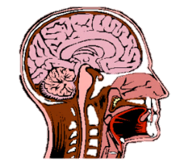
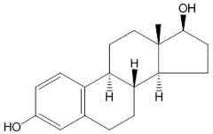
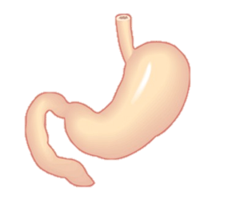
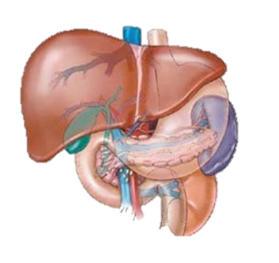

WHAT DO HORMONES DO?
Hormones act as a form of communication between organs in the body and help control lots of important processes including digestion, metabolism, growth and development, reproduction and sleep.
Sex Hormones control puberty, egg and sperm production, pregnancy, birth and lactation. They affect the way males and females look and behave and determine when they mate and with who!

