Slide 1
Teaching chemistry to non-specialists at the Open University
Nick Chatterton (School of Life, Health and Chemical Sciences)

Slide 2
OU chemistry for “non-chemists”.
Open access
Online supported distance learning
Q64 Natural Sciences and Q71 Health Sciences
Open Degree
MSc – Medicinal Chemistry

Slide 3



OU Level 1 – studied by around 5000 students annually

Slide 4
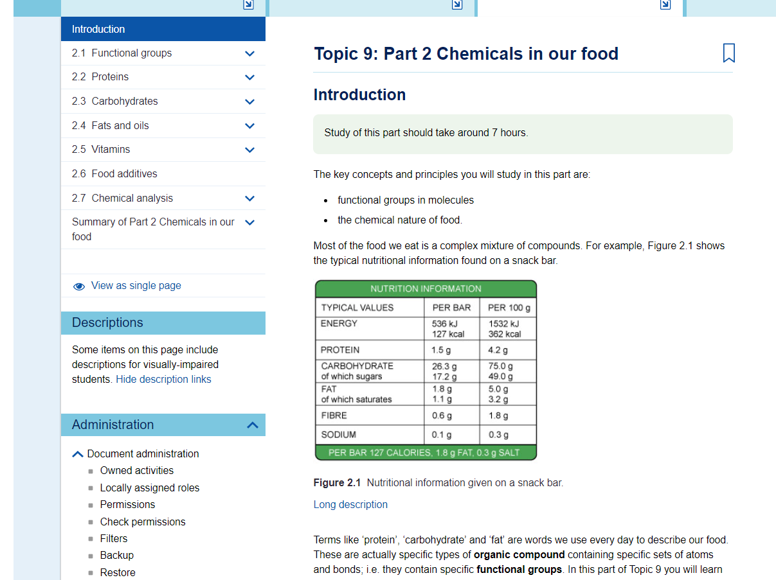
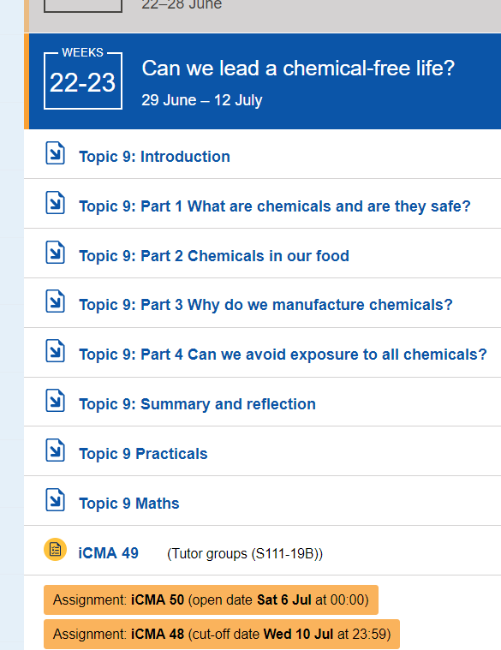

Slide 5
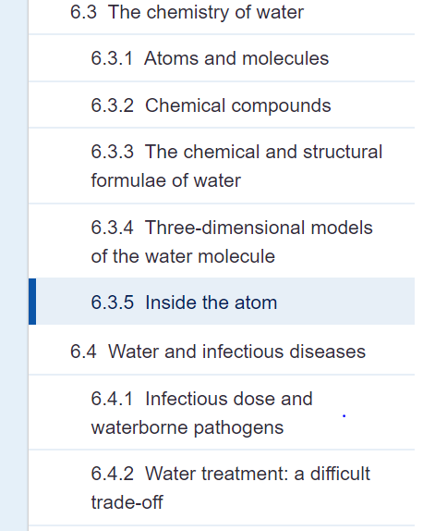
Context/question driven aka “sneaking the chemistry in”
Students interest piqued via an interesting
and relevant context
E.g. Topic 1 on infectious disease in SDK100

Slide 6
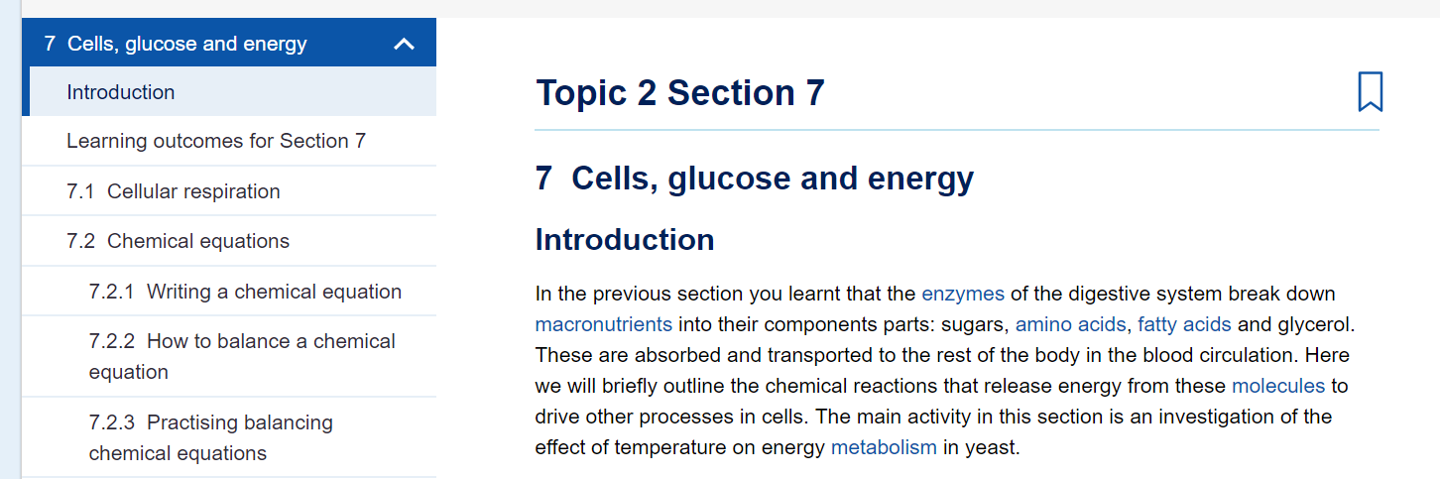
Learning the chemistry when they need it

Slide 7
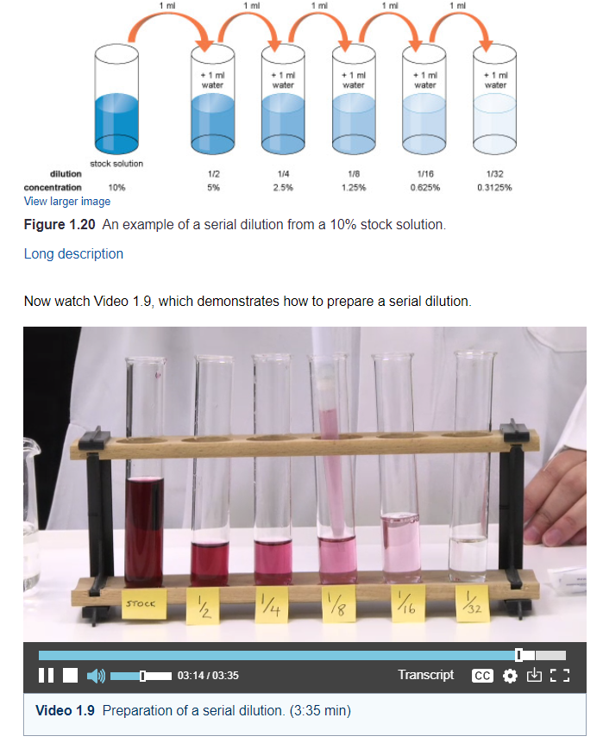
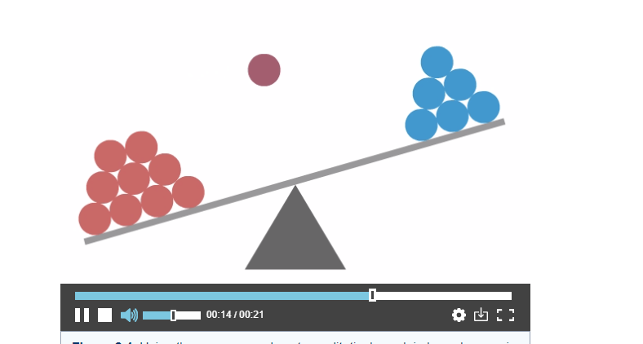
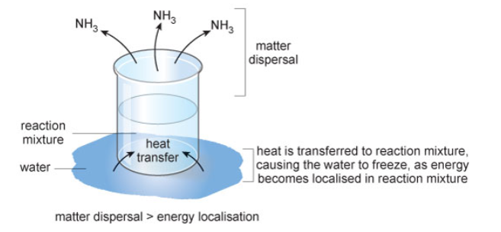
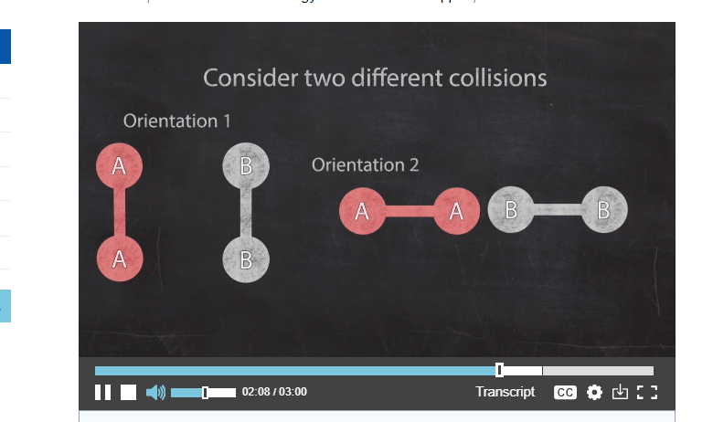
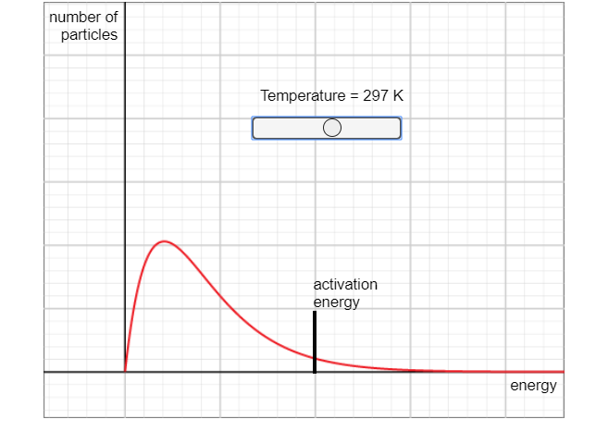
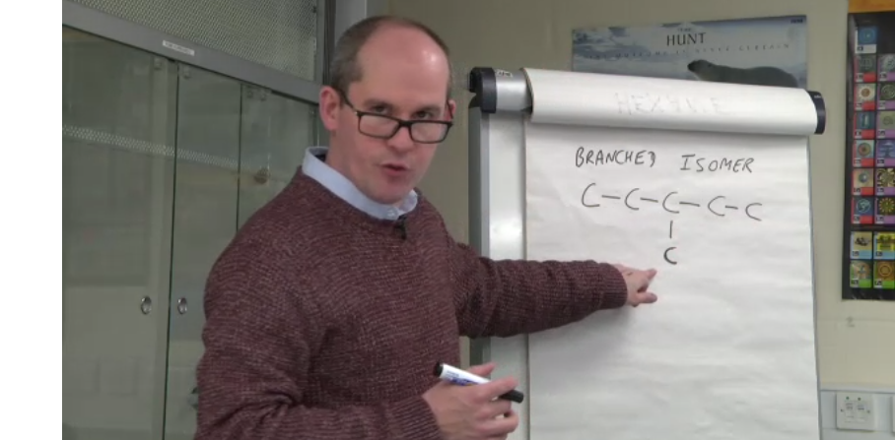
Bringing the subject matter to life on screen.

Slide 8
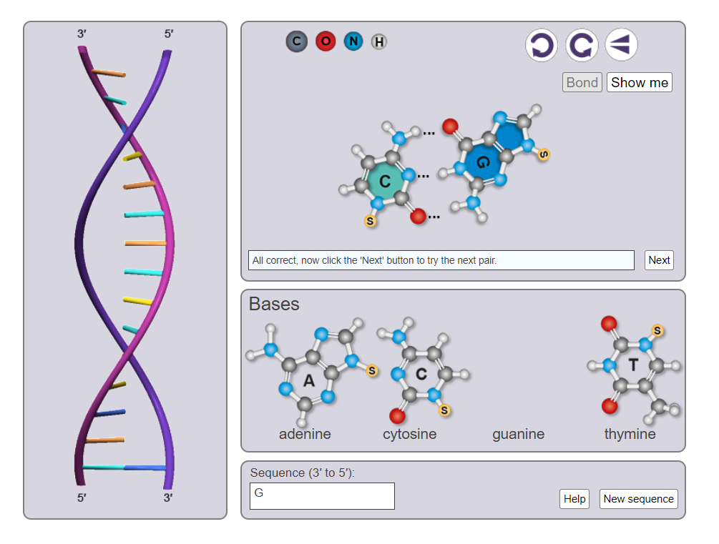
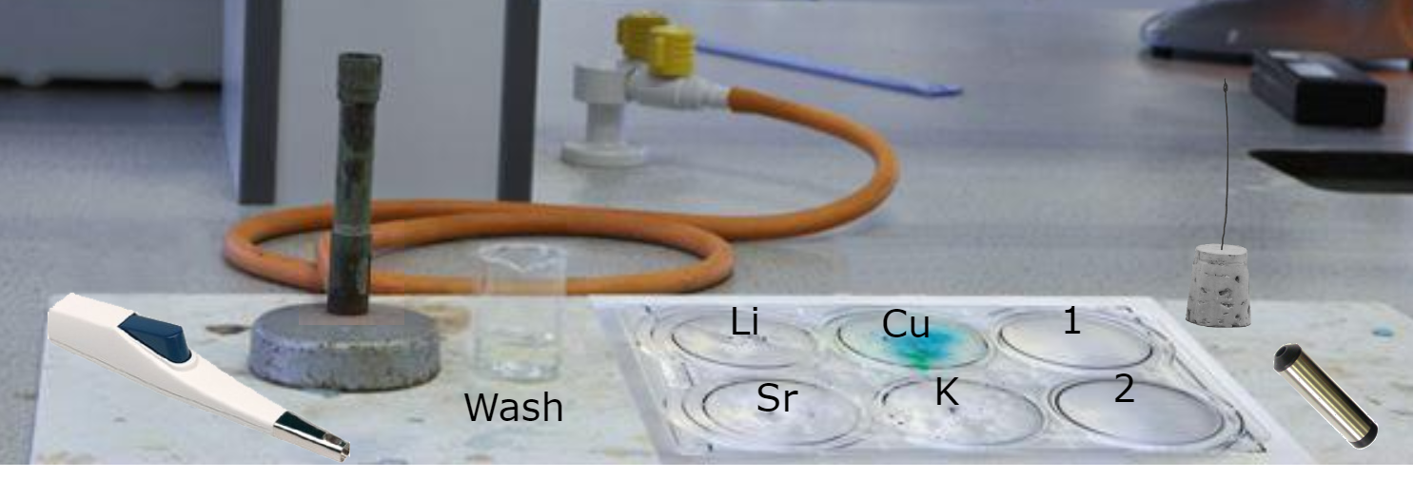
Games/interactives
Open Science Laboratory
https://learn5.open.ac.uk/course/view.php?id=2

Slide 9
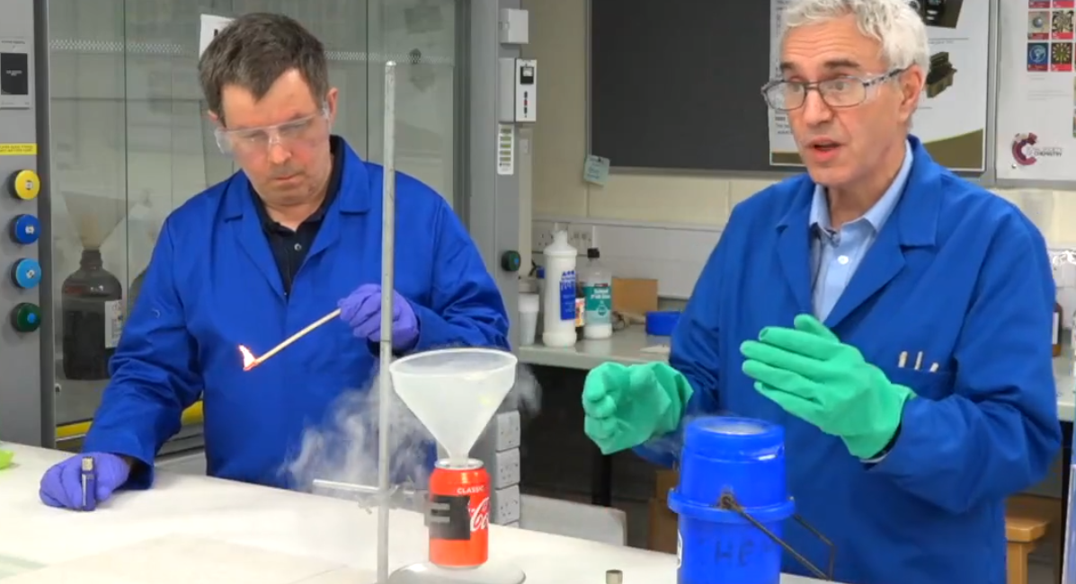
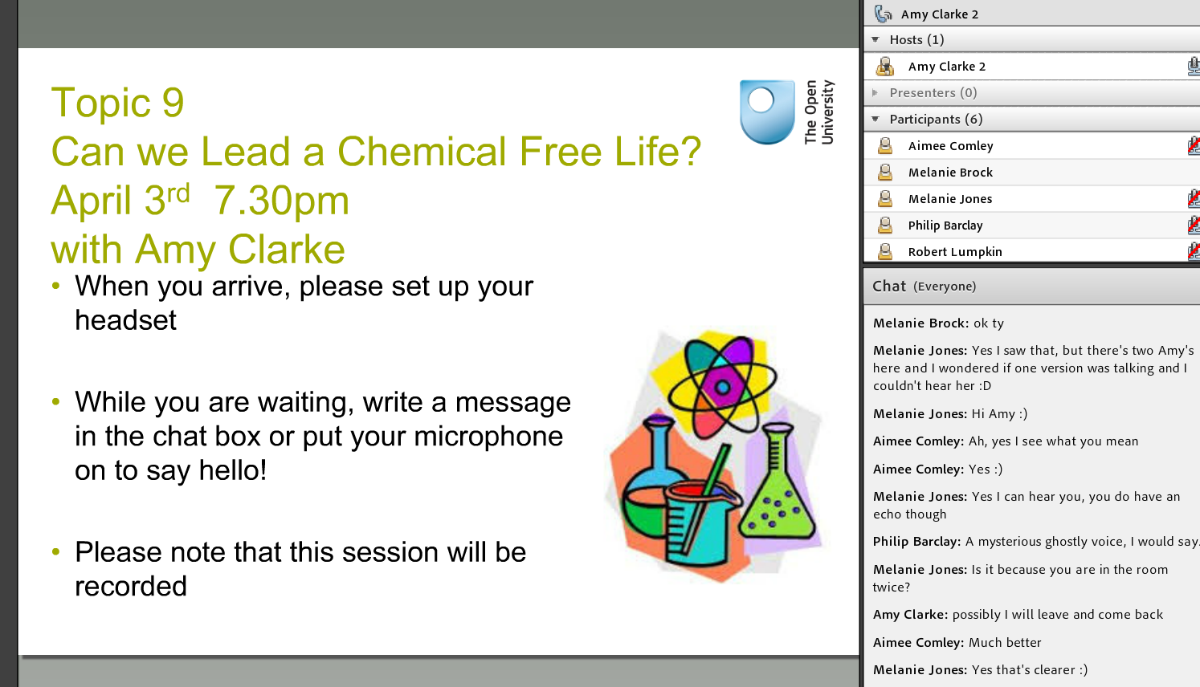
Going live
Labcasts
Online tutorials (Adobe Connect)

Slide 10
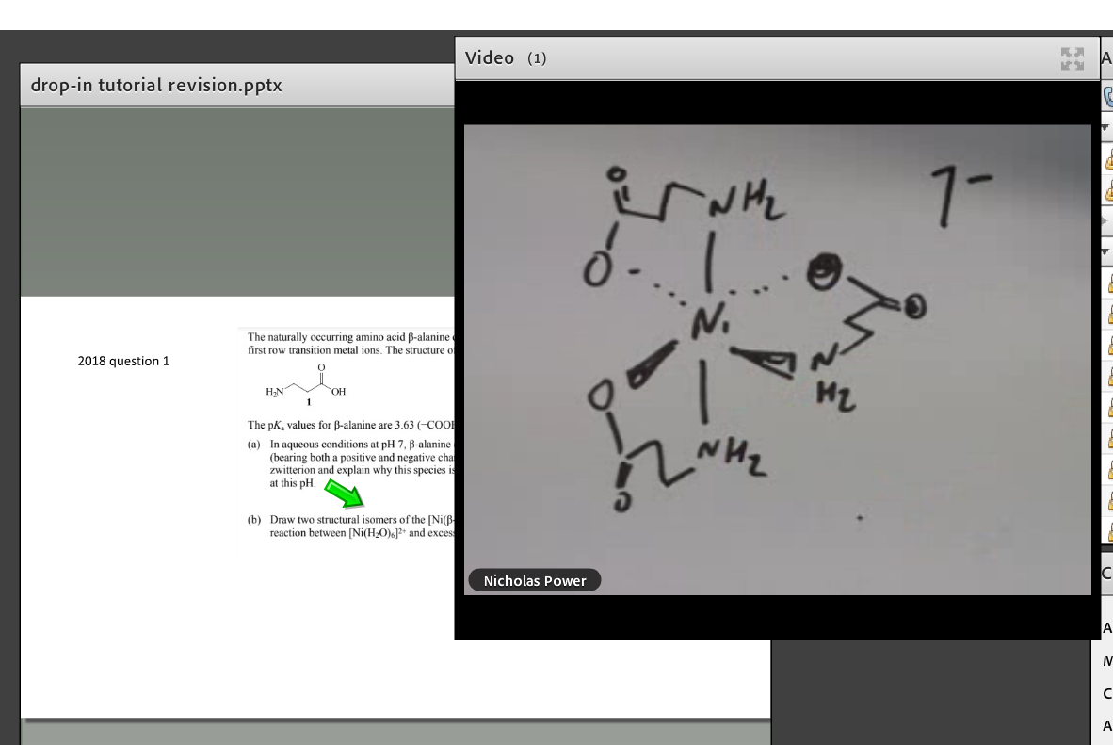

Online chalk and talk

Slide 11
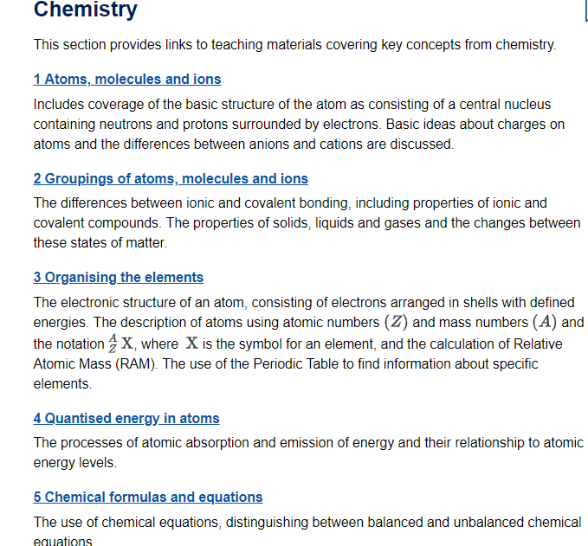
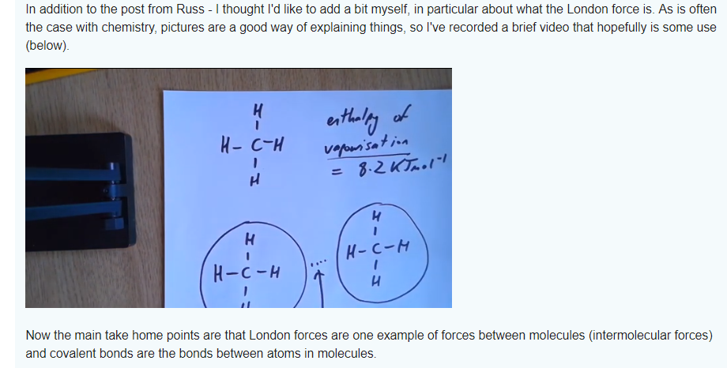
Additional support for those struggling
S112: use of short videos in response to forum queries
S201 primer

Slide 12
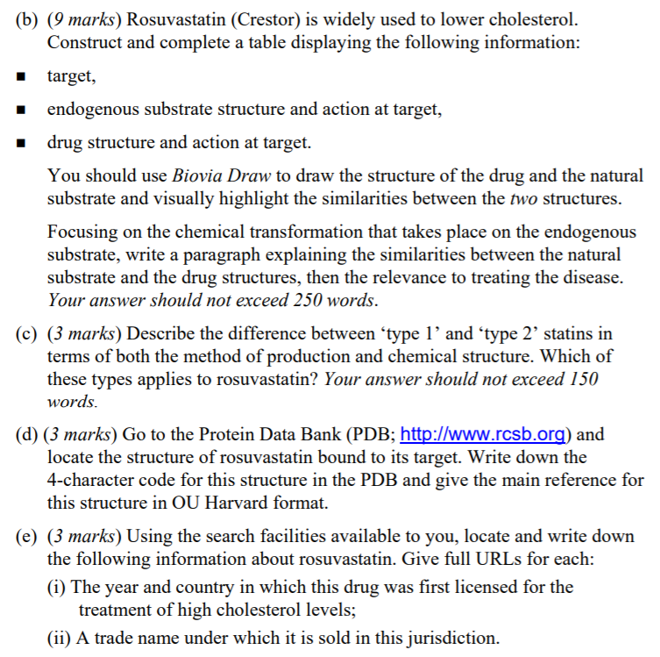
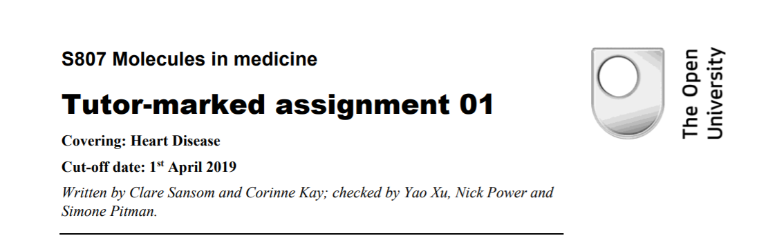
Learning by doing

Slide 13
Summary
Various strategies used to support non-specialist chemists
Context/relevant questions
Learning materials when needed
“Sneaking it in”
Learning by doing and through assessment
Using a combination of text + pictures, interactive features, video, animations and live teaching

