Slide 1

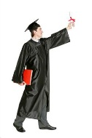


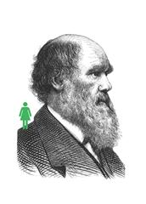

Student membership
Strengthen your CV
Demonstrate commitment to your future in the biosciences. After graduation, you can apply to become an AMRSB member.
The Biologist
6 issues per year to keep you up to date with what’s happening in the life sciences and monthly members e-newsletter.
Life Sciences Careers Conference
Explore career options and meet the experts at a national careers conference – FREE!
Join our network
Gain access to a network of 15,500 members all with an interest in biology – including your lecturers, future colleagues and employers.
Money off books
Take advantage of a 20% discount on all life science titles from leading academic publisher Wiley Blackwell.

