Slide 1
The Royal Society of Biology

Slide 2
What is a Professional Body?
‘a non-profit organisation seeking to further a particular profession, the interests of the individuals engaged in that profession and the public interest’
Notes:
FIRSTLY, WHAT IS A PROFESSIONAL BODY?
- There’s many different professional bodies, such as the Association of Chartered Certified Accountants (ACCA), the Medical Royal Colleges, Institute of Fundraising and British Horse Society!
- The RSB supports the biosciences, and your future within it.

Slide 3
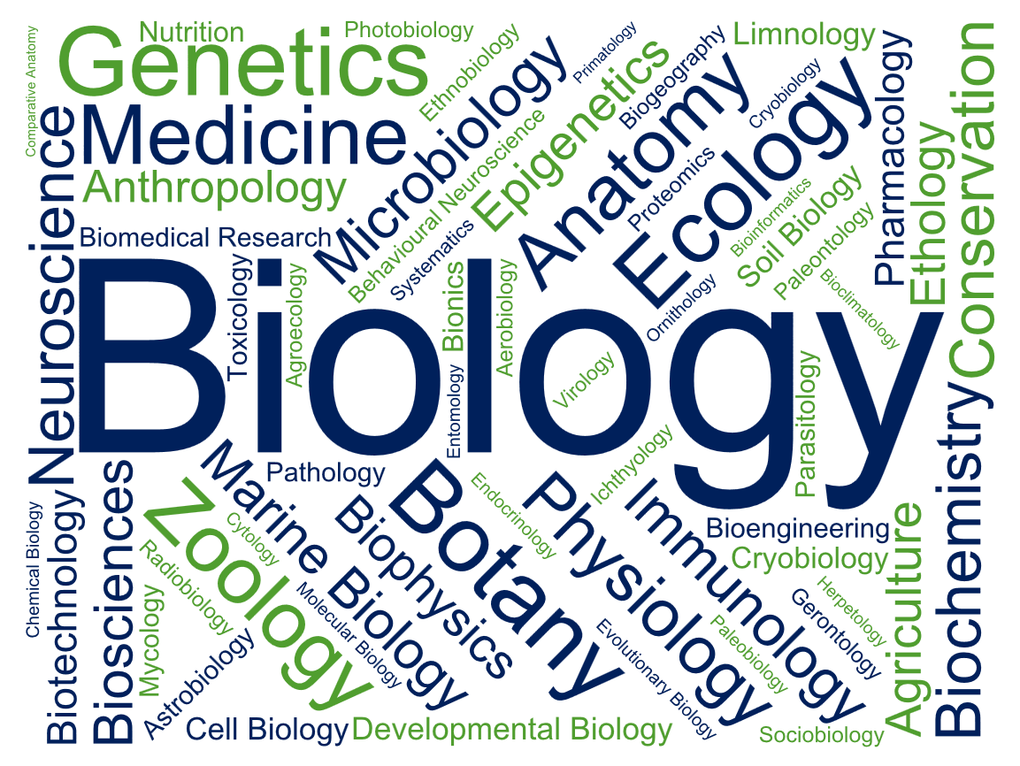
Notes:
AM I ELIGIBLE TO BECOME A MEMBER?
We’re often asked, “If I don’t have the word ‘biologist’ in my title, does it mean I can’t become a member of the RSB?”
Up here are the different disciplines we promote, and our members work in - all of them are united by a core appreciation and understanding of biology, but the applications look very different!
So if any words there relate to what you do, or what you’re interested in, then you’re absolutely welcome to become a member of the Royal Society of Biology

Slide 4
Key Activities
Advise government and influence policy
Advance education and professional development
Support and represent people working in the biosciences
Engage and encourage public interest in the biosciences
Notes:
TO SUMMARISE, THESE ARE THE FOUR KEY AREAS THE ROYAL SOCIETY OF BIOLOGY WORKS IN

Slide 5
Our Membership
Our Individual Members include:
Practising scientists and technicians
Nobel Laureates
Students at all levels
Life sciences professionals in academia, industry, education & policy
Non-professionals with an interest in biology
Our Organisational Members include other life science organisations and companies that support us to be the unifying voice of biology
Notes:
OUR MEMBERSHIP
We have over 17,000 Individual Members and 90 Organisational Members across the country… and world!

Slide 6
How Can We Support You?
Information and updates
Careers support and advice
Networking opportunities
Public engagement
Grants, awards & competitions
Professional development

Slide 7
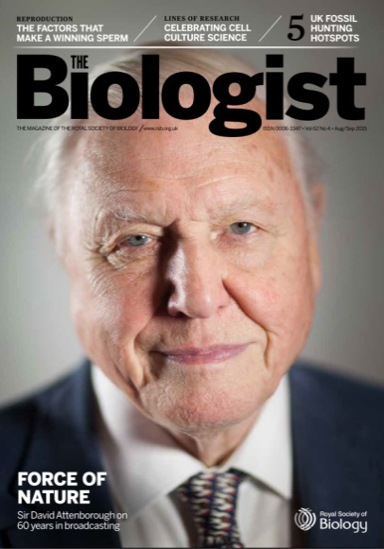
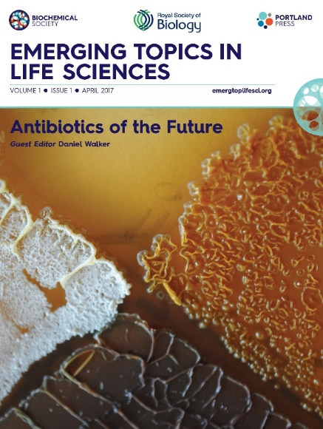
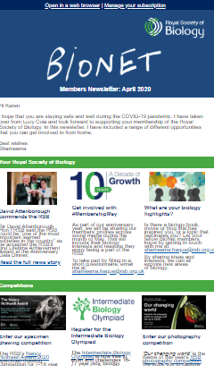
Explore the Biosciences
Award-winning members’ magazine, The Biologist
Access to Emerging Topics in the Life Sciences journal and Oxford Biology Primers
Regular and topical newsletters on developments in science and the RSB's work…
Notes:
THE BIOLOGIST MAGAZINE
All members of the Society receive a free subscription to our peer reviewed magazine The Biologist. Biology is brought to life through an impressive range of review articles, whilst topical pieces discuss science policy, new developments or controversial issues.
Like the New Scientist of Biology, looking at areas of the life sciences you may not have covered since school!
EMERGING TOPICS IN THE LIFE SCIENCES
Written for an interdisciplinary audience, each issue focusses on a new, or growing, key topic and is guest edited by an expert in that field.
Open access articles are available for all editions.
OXFORD PRIMERS
the RSB’s textbook series, published in partnership with Oxford University Press. These textbooks aim to give students aged 16-19 a first taste of studying biology beyond school.
TOPICAL NEWSLETTERS
Stay up to date with the latest science policy developments with our weekly science policy newsletter, a concise breakdown on what has happened over the past week - from health and biomedicine to environment and ecology, from government and parliament to research funding policy.
Subscribe to our other monthly newsletters to receive news, events, the latest grants, competitions & awards.

Slide 8
Biomedical Sciences
Environmental and Ecosystem Science
Agriculture and Plant Science
Science in Parliament
Research Environment and Practice
Equality and Diversity
Biology Education in the UK
Notes:
KEY POLICY AREAS
Find out what’s happening in all of these different areas of the life sciences

Slide 9
Develop Professionally
Access our reputable CPD scheme
Discounted training courses for all abilities and interests
Careers support and advice
Notes:
CPD and TRAINING
Continue your Professional Development as a member and save 50% off our training courses.
From Persuasive Scientific Report Writing and Commercial Awareness for Life Scientists, to introduction to Science Communication – we want you to expand your expertise.
Courses available online.
Log your CPD points using our online CPD scheme.
OUR JOBS BOARD
Check online for new job opportunities
Use our ONLINE CAREERS RESOURCES for advice on what to do next
ANNUAL BIOSCIENCE CAREERS DAY
Hear experts give top tips on exciting careers available to you with a biological sciences degree
Book a mock interview to sharpen your technique for future employers
Network with biology professionals and other students from across the UK
Watch science communicators live on stage & meet them afterwards
Meet representatives from a variety of top organisations in our exhibition and ask them informal questions over lunch

Slide 10
Opportunities
Invitations to attend online and UK-wide bioscience events
Join your RSB regional branch
Travel grant
Notes:
ATTEND AN RSB EVENT
RSB organises events including fundraisers, such as an evening with Sir David Attenborough for our 10 year anniversary.
Other events include our AGM, Charter Lectures and Fellow’s lunches to name but a few.
JOIN YOUR REGIONAL BRANCH
There are several regional branches across the UK, and one in Southeast Asia and Australasia. {you can find your regional branch here: www.rsb.org.uk/regional-activity)
Once you become an elected member, you can get involved with your regional branch to help create events or projects engaging biologists and the public.
YOUR REGIONAL BRANCH
{Find your regional branch here: https://www.rsb.org.uk/regional-activity and input a contact email, upcoming events, recent events and some pictures}
TRAVEL GRANTs
Up to £1,000 grant for UK or overseas travel in connection with biological study, teaching or research for those who would otherwise be unlikely to have it. If you want to do a work placement, or visit a conference, do a apply to the RSB for this money to support you.
JOIN YOUR PROFESSIONAL NETWORK
Meeting other like-minded members, who are involved in academia, industry and education
Attend events, volunteer, get involved with your regional branch – you can develop invaluable skills, and meet people who could give you an insight into your future career.

Slide 11
Get Involved
Volunteering roles at outreach and engagement events
Exclusive member grants and awards
Annual Biology Week
Notes:
VOLUNTEER IN PUBLIC ENGAGEMENT
Volunteer with the Society at a range of science fairs and festivals round the country, contact Amanda to express your interest.
Biology Week showcases the important and amazing world of the biosciences, getting everyone from children to professional biologists involved in fun and interesting life science activities – get involved creating or setting up an event! See the website for ideas.
OUTREACH AND ENGAGEMENT GRANT SCHEME
If you have an idea for an event and are looking for some additional funds to help make it a success, you can apply for either a small grant of £50 - £200 or a full grant of £201 - £500.
ENTER A COMPETITION OR APPLY FOR AN AWARD
You may win the top student award if you graduate top of your class
Winner of the photography competition wins £500

Slide 12
Join Today
Why not join your professional association today for just £15 a year as a student affiliate member
Upon graduating, you will be automatically upgraded to use the AMRSB post-nominal letters to boost your recognition
Notes:
JOIN AS A STUDENT AFFILIATE FOR JUST £15 A YEAR
{you can download and print forms here www.rsb.org.uk/toolkit to hand out to the students, request a quick-join link at toolkit@rsb.org.uk or ask them to get in touch with membership@rsb.org.uk}
UNDERGRADUATE MEMBERSHIP
For £15/year, undergraduate membership includes:
The Biologist & e-newsletters
Careers Conference & Resources
Money off books & apply for Grants
Strengthen your CV and join our network
POST-NOMINAL LETTERS
Upgrade to associate grade is free of charge
Boost your professional recognition by using our post-nominal letters.

Slide 13
Contact:
www.rsb.org.uk/join
membership@rsb.org.uk

