Slide 1
Royal Society of Biology

Slide 2
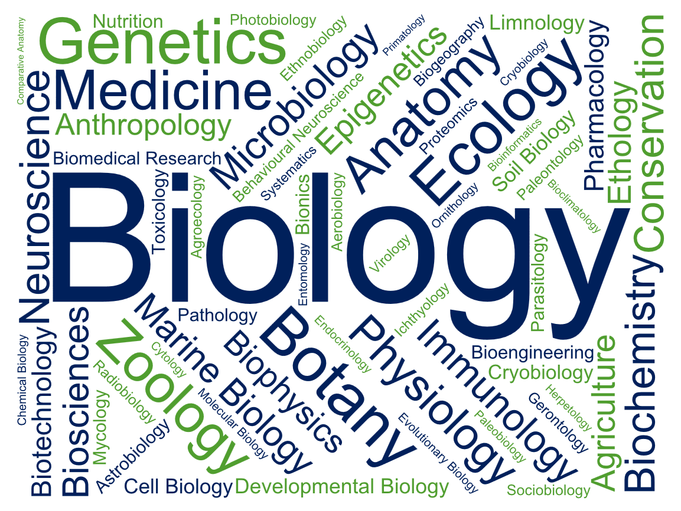
Notes:
AM I ELIGIBLE TO BECOME A MEMBER?
We’re often asked, “If I don’t have the word ‘biologist’ in my title, does it mean I can’t become a member of the RSB?”
Up here are the different disciplines we promote, and our members work in - all of them are united by a core appreciation and understanding of biology, but the applications look very different!
So if any words there relate to what you do, or what you’re interested in, then you’re absolutely welcome to become a member of the Royal Society of Biology

Slide 3
Our History
Merger of the Biosciences Federation and the Institute of Biology to form the Society of Biology
Granted the Royal Title in May 2015 to become the Royal Society of Biology
(1950-2009)
(2002-2009)
(2009-2015)
(2015)
Notes:
OUR HISTORY
Many of you here may not necessarily recognise our name, and there’s a good reason why.
Some of you may have known the Institute of Biology? They’re one of the parent organisations that became what is now known today as the Royal Society of Biology
Chemistry had the Royal Society of Chemistry, Physics had the Institute of Physics, but for the Biological Sciences, there were about 100 membership bodies.
The government and policy making organisations wanted one key organisation to convene with, so the Institute of Biology merged with the Biosciences Federation to form the Society of Biology in 2009
In 2015, we were granted our Royal title, which is a tremendous accolade for the work we are doing to fulfil our charitable initiatives and support the life sciences in the UK.

Slide 4
Our Goals
Our vision is of a world that understands the true value of biology and how it can contribute to improving life for all
Our mission is to be the unifying voice for biology
Facilitate the promotion of new discoveries in biological science
Engage the wider public with our work
Notes:
WHAT WE STAND FOR
Our vision
and mission

Slide 5
Membership
Our Individual Members include:
Practising scientists and technicians
Students at all levels
Life sciences professionals in academia, industry, education and policy
Non-professionals with an interest in biology
Our Organisational Members include other life sciences organisations and companies
Notes:
OUR MEMBERSHIP
We have over 17,000 Individual Members and almost 90 Organisational Members across the country… and world!

Slide 6
Key Activities
Advise government and influence policy
Advance education and professional development
Support and represent people working in the biosciences
Engage and encourage public interest in the biosciences
Notes:
TO SUMMARISE, THESE ARE THE FOUR KEY AREAS THE ROYAL SOCIETY OF BIOLOGY WORKS IN

Slide 7
Membership Benefits
Information and updates
Professional recognition
Networking opportunities
Engage the Public
Support the future of biology
Professional development

Slide 8
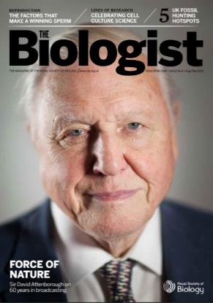
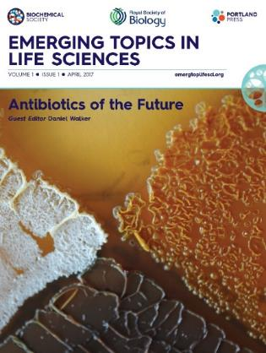
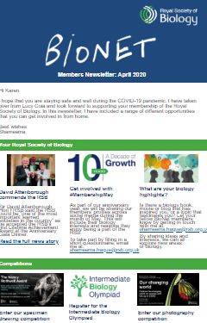
Information and Updates
Award-winning members’ magazine, The Biologist
Access to Emerging Topics in the Life Sciences journal and Oxford Biology Primers
Regular and topical newsletters on developments in science and the RSB's work
Notes:
TOPICAL NEWSLETTERS
Stay up to date with the latest science policy developments with our weekly science policy newsletter, a concise breakdown on what has happened over the past week - from health and biomedicine to environment and ecology, from government and parliament to research funding policy.
Subscribe to our other monthly newsletters to receive news, events, the latest grants, competitions & awards.
Quarterly THE BIOLOGIST
All members of the Society receive a free subscription to our peer reviewed magazine The Biologist. Biology is brought to life through an impressive range of review articles, whilst topical pieces discuss science policy, new developments or controversial issues.
Like the New Scientist of Biology, looking at areas of the life sciences you may not have covered since school!
EMERGING TOPICS IN THE LIFE SCIENCES
Written for an interdisciplinary audience, each issue focusses on a new, or growing, key topic and is guest edited by an expert in that field.
Open access articles are available for all editions.
OXFORD PRIMERS
the RSB’s textbook series, published in partnership with Oxford University Press. These textbooks aim to give students aged 16-19 a first taste of studying biology beyond school.

Slide 9
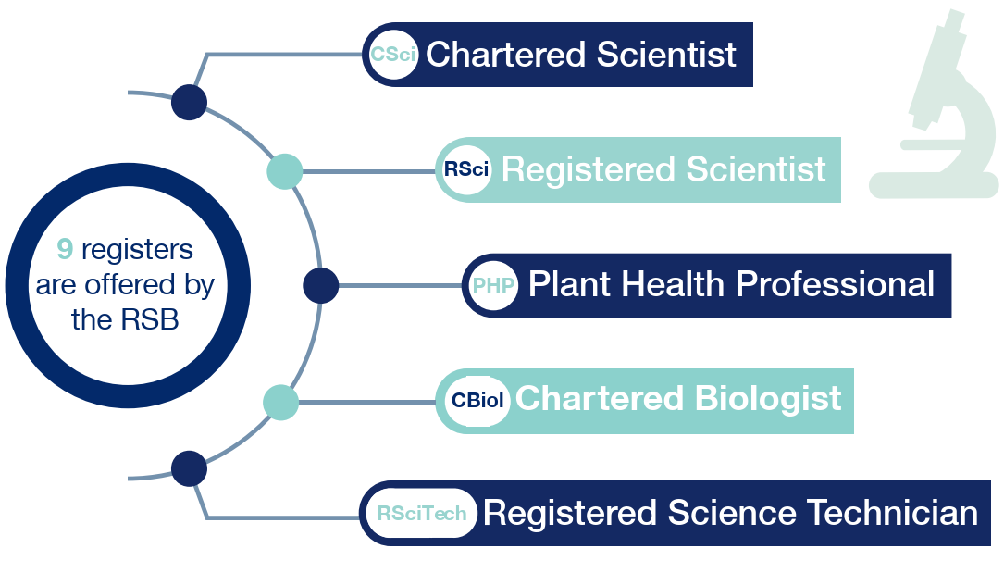
Professional Recognition
Achieve Chartered or Registered status through our professional registers
Post-nominal letters
Notes:
POST-NOMINAL LETTERS
Boost your professional recognition by using our post-nominal letters.
PROFESSIONAL REGISTERS
These recognise the range of knowledge, experience and professionalism that are sought after by employers and demanded by the public – to find out more visit www.rsb.org.uk/registers
We run our own professional register Chartered Biologist, the Science Council Registers for Registered and Chartered Scientist, and other registers such as Qualified Person.

Slide 10
Professional Development
Access our reputable CPD scheme
Discounted training courses for all abilities and interests
Careers support and advice
Notes:
CPD TRAINING
Continue your Professional Development as a member and save 50% off our training courses.
From Persuasive Scientific Report Writing and Commercial Awareness for Life Scientists, to introduction to Science Communication – we want you to expand your expertise.
Courses available online.
Log your CPD points using our online CPD scheme.
OUR JOBS BOARD
Check online for new job opportunities
Use our ONLINE CAREERS RESOURCES for advice on what to do next
ANNUAL BIOSCIENCE CAREERS DAY
Hear experts give top tips on exciting careers available to you with a biological sciences degree
Book a mock interview to sharpen your technique for future employers
Network with biology professionals and other students from across the UK
Watch science communicators live on stage & meet them afterwards
Meet representatives from a variety of top organisations in our exhibition and ask them informal questions over lunch

Slide 11
Networking Opportunities
Invitations to attend online and UK-wide bioscience events
Join your RSB regional branch
Travel grants
Notes:
ATTEND AN RSB EVENT
RSB organises events including fundraisers, such as an evening with Sir David Attenborough for our 10 year anniversary.
Other events include our AGM, Charter Lectures and Fellow’s lunches to name but a few.
JOIN YOUR REGIONAL BRANCH
There are several regional branches across the UK, and one in Southeast Asia and Australasia. {you can find your regional branch here: www.rsb.org.uk/regional-activity)
Once you become an elected member, you can get involved with your regional branch to help create events or projects engaging biologists and the public.
YOUR REGIONAL BRANCH
{Find your regional branch here: https://www.rsb.org.uk/regional-activity and input a contact email, upcoming events, recent events and some pictures}
TRAVEL GRANTs
Up to £1,000 grant for UK or overseas travel in connection with biological study, teaching or research for those who would otherwise be unlikely to have it. There are 2 categories.
AMRSB members.
MRSB members in the early stages of their research careers (0-5 years in paid employment) only.

Slide 12
Support the Future of Biology
Input into UK bioscience education and science policy
Parliamentary and policy events
Join committees and groups to strengthen your portfolio or CV
Notes:
POLICY
The RSB wish to provide a balanced response, reflecting the views of the biosciences profession:
We do this in consultation with our Member Organisations and Individual Members
We perform both proactive and reactive policy work
PARLIAMENTARY & POLICY EVENTS
Links Day is the largest science event on the annual Parliamentary events calendar, and is organised by the RSB on behalf of the science and technology community, bringing together scientists, learned societies and Members of Parliament.
Voice of the Future is an annual event that brings young scientists and engineers together to quiz key political figures at the Houses of Parliament about the science policy issues that matter to them.
Throughout the year, a collaboration of several societies run a series of Policy Lunchbox lunchtime events to bring together guest speakers with those who work in science policy.
GROUPS AND COMMITTEE’S EVENTS
The RSB has several Special Interest Groups that run their own interdiscplinary events that you are welcome to attend, such as:
UK Plant Sciences Federation
Natural Capital Initiative
Heads of University Biosciences
EDUCATION
The RSB are committed to supporting and encouraging the study of biology at all levels:
We are contributing to curriculum development through the work of our curriculum committee, primary working group and student group.
We have developed resources to support teachers and students in primary, secondary and higher education.
Students have a chance to show their brilliance in biology whilst taking part in our competitions.
Teachers can gain recognition with awards for excellence in teaching at university, secondary and primary school level and by applying for the Chartered Science Teacher register.

Slide 13
Engage the Public
Volunteering roles at outreach and engagement events
Exclusive member grants and awards
Annual Biology Week
Notes:
VOLUNTEER IN PUBLIC ENGAGEMENT
Volunteer with the Society at a range of science fairs and festivals round the country, contact Amanda to express your interest.
Biology Week showcases the important and amazing world of the biosciences, getting everyone from children to professional biologists involved in fun and interesting life science activities – get involved creating or setting up an event! See the website for ideas.
OUTREACH AND ENGAGEMENT GRANT SCHEME
If you have an idea for an event and are looking for some additional funds to help make it a success, you can apply for either a small grant of £50 - £200 or a full grant of £201 - £500.
ENTER A COMPETITION OR APPLY FOR AN AWARD
You may win the top student award if you graduate top of your class
Winner of the photography competition wins £500

Slide 14
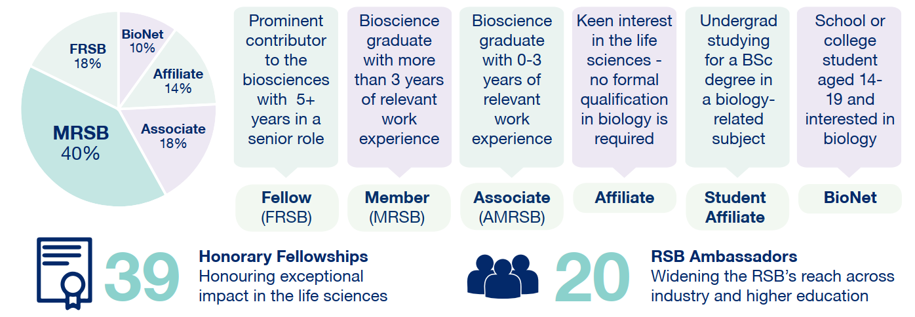
Grades of RSB Membership
Notes:
THESE ARE THE DIFFERENT GRADES OF MEMBERSHIP
Affiliate: Anyone with an interest in the life sciences
Student Affiliate: undergraduate student studying a biology-related subject
Associate (AMRSB): Awarded a degree containing at least 50% biology in the final two years of study. Also a *CPD route
Member (MRSB): Graduate in a bioscience subject with at least three years’ postgrad experience. Also a *CPD route
Fellowship (FRSB): Prominent contribution to the advancement of the biological sciences, at least five years’ experience in a position of senior responsibility
<*CPD route recognises that someone can obtain an equivalent level of experience through working in the life sciences.
You can use the Membership benefits spreadsheet for more in depth information>
DISCOUNTS are available if you are a Recent Graduate (<2 years since finishing undergraduate degree), a Masters or PhD Student, in Unpaid Employment, Retired or on a Career Break, or a member of one of our Member Organisations.

Slide 15
Join Today
Why not join your professional association today and support the biosciences:
www.rsb.org.uk/join
membership@rsb.org.uk
Notes:
IF YOU’RE INTERESTED, PLEASE EMAIL RSB

Slide 16
Thank you
Our strategic partner group:

