Slide 1
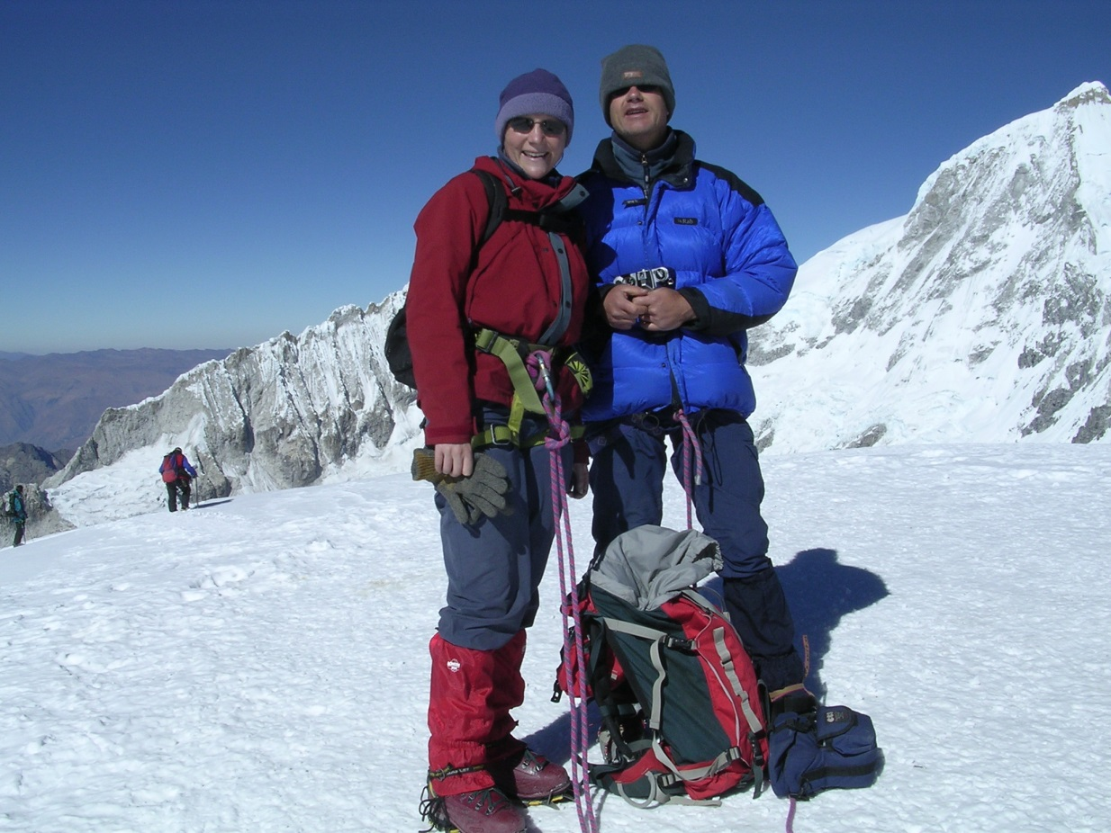
I never really enjoyed Biology at school – I just couldn’t see the point of the practicals...

Slide 2
Government survey on uptake of science at university
“I didn’t enjoy Biology at school – I just couldn’t see the point of the practical work...”

Slide 3
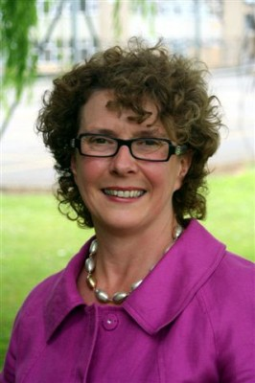
I never really enjoyed science at school – I just couldn’t see the point of the practicals...

Slide 4
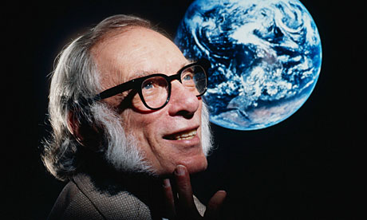
Most exciting words in science…?

Slide 5
C. “eureka!”
A. “Oh, look. It does exactly what you said it would…”
B. “What’s supposed to happen...?”
D. “That’s funny...”

Slide 6
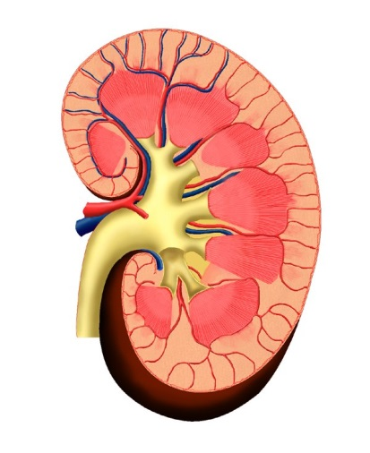
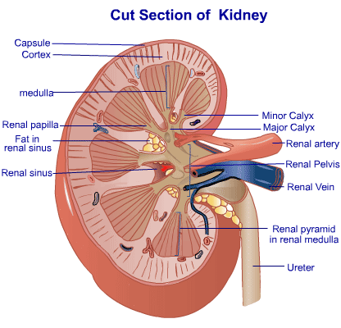
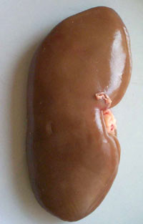
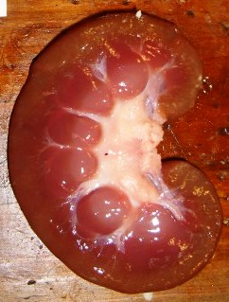
Function of kidney:
Excretion
Osmo-regulation
Function of kidney:
Blah blah blah

Slide 8
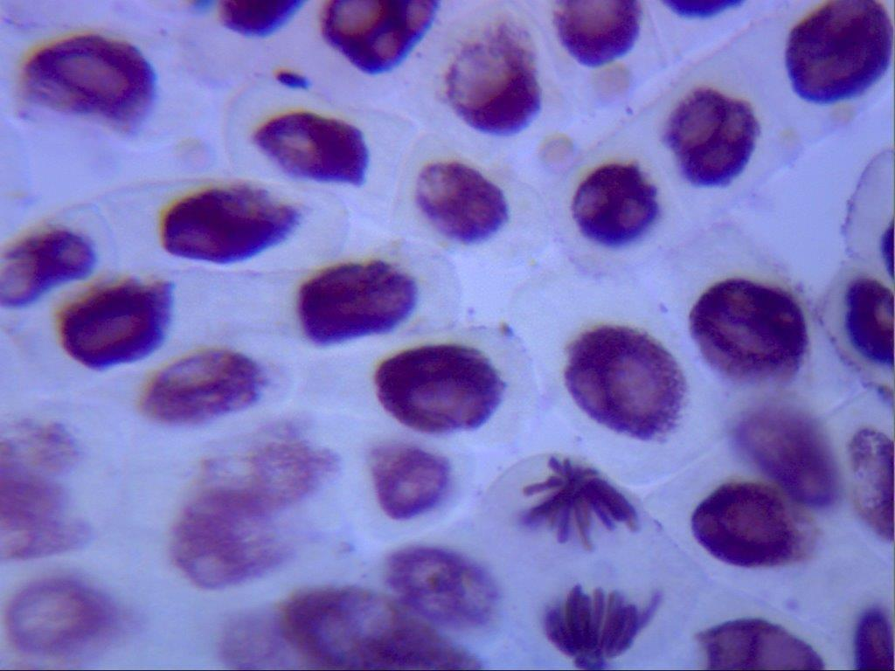

Slide 9
