Slide 1
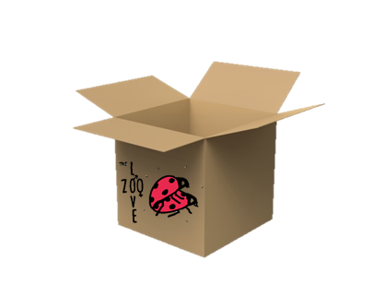
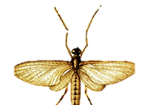
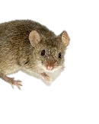
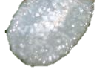
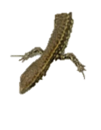

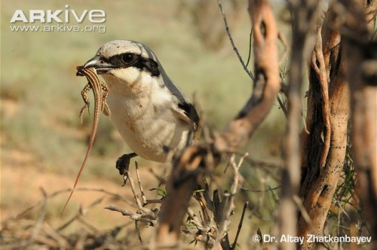
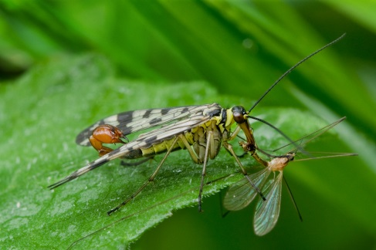
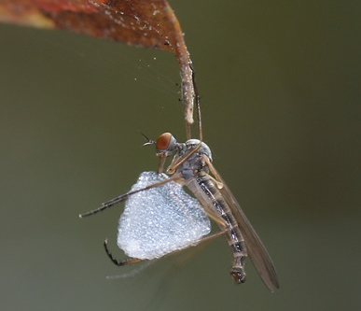


What is a Nuptial Gift?
Nuptial gifts are food items or inedible tokens that are transferred to females by males during courtship or mating. Inedible tokens may include items such as a fragment of leaf or twig, a seed tuft, or a silk balloon.
Nuptial gifts act as an indicator of male fitness
Great Grey Shrike
Scorpion Fly
Balloon Fly
Male Great Grey Shrikes give females dead rodents or lizards that they have impaled on a spike!
In the scorpionfly (Panorpa cognata), males offer a salivary secretion as a nuptial gift before copulation.
Male balloon-flies catch an insect, kill it, wrap it a ball of silk, and offer it to females in mating swarms.

Slide 2


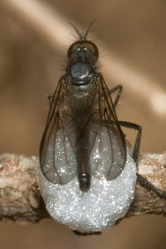
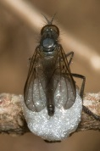
Make Your Own Balloon Fly!
Balloon flies are one group of the family of true flies called Empididae.
There are a number of species of balloon-flies; they differ in shape and size. All balloon flies share a surprising mating behaviour…..
Balloon flies offer ‘nuptial gifts’ to attract mates.
Male balloon-flies catch an insect, kill it, wrap it a ball of silk, and offer it to females in mating swarms.
What is a mating swarm?
Swarms are large groups of insects. When in the mating swarms male balloon-flies fly up and down in a sort of dance.
How do females choose their mate?
Females seem to choose the male with the most enticing balloon offering. Sometimes a male may offer just an empty ball of silk. If there is something inside the balloon the female chooses she may eat it.

