Slide 1

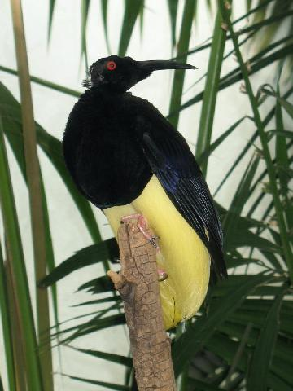



The Tickler
Twelve-wired bird of paradise
The male twelve-wired bird of paradise really knows how to tickle the ladies. In an intimate act that scientists call “wire-wipe display,” during courtship the male twelve-wired bird of paradise repeatedly brushes the female’s face with the dozen stiff feather shafts protruding from his lower torso.
The female obviously finds the sensation appealing: she often approaches the male from behind to place her head among his “wires.”

Slide 2
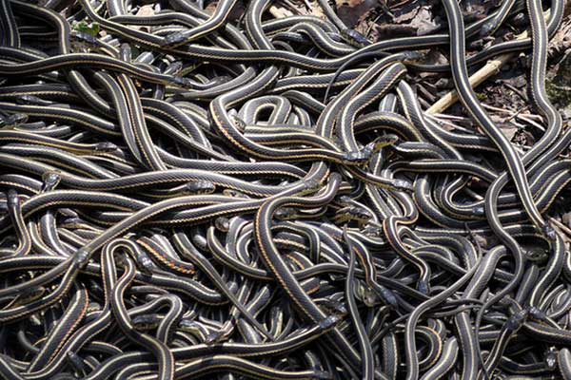

The Sharer
Red-sided garter snake
During the mating season, the red-side garter snake will engage in a massive group mating session, with one female taking on hundreds of partners. The female produce a sex-specific pheromone that attracts male snakes in droves, sometimes leading to intense male to male competition.
Male garter snakes sometimes produce ‘female’ pheromones, which fools other males into attempting to mate with them, warming them up nicely after hibernation

Slide 3
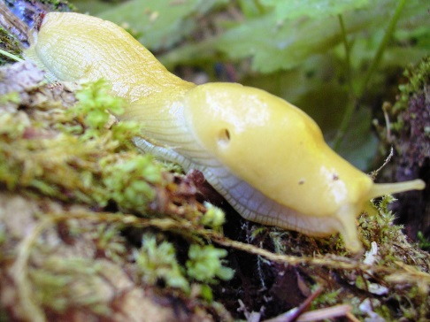
The Nibbler
Banana Slug
Banana slugs are hermaphrodites. They have the reproductive organs of both the sexes, can act as both male and female at the same time, and on rare occasions, will mate with themselves. Their Latin name, dolichophallus, means ‘giant penis’. It’s a fitting name too as they do all have enormous penises, almost as long as their entire body length. If a Banana slug is to mate properly, it has to choose a partner of equal size.
If it doesn’t, the chances are that its penis will get stuck.
Unable to pull out afterward, the only option left is to bite off the other slug’s
reproductive organ.

Slide 4
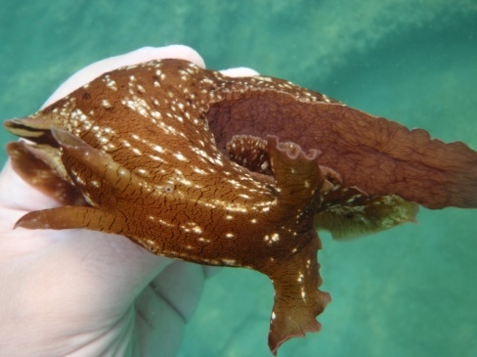
The Swinger
Sea Hare (sea slug)
This critter has been practicing free love for millennia. The sea hare, a kind of sea slug, is a hermaphrodite that sometimes mates in chains, with the animals in the middle acting as both a male and a female simultaneously. This love chain can yield millions of eggs.

Slide 5
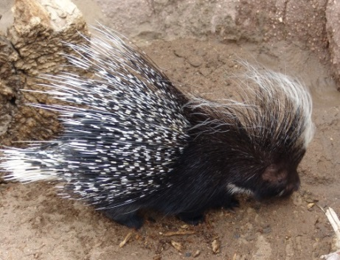
The Water Boy
Porcupine
From up to seven feet away the male will drench a female in urine. If it turns her on and she is impressed with his pheromones, then they will mate, and she won’t let him stop until he’s physically exhausted. When that happens, she finds another prickly partner with a full bladder.
Porcupine sex is very rare as females only are receptive to sexual advances for about 8-12 hours per year, usually during late summer or early fall.

Slide 6
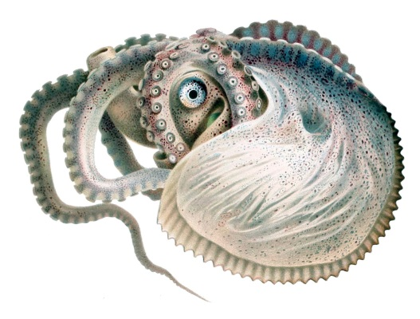
The Detached Lover
Argonaut (octopus)
This octopus technically has eight arms, but it's safe to say the Argonaut has one extra - its super long detachable penis. When a female swims by, the lazy male Argonaut sends his penis off to swim to the female and mate with her. In the past, scientist that caught female specimens confused the attached males penis for for a parasitic worm!

Slide 7
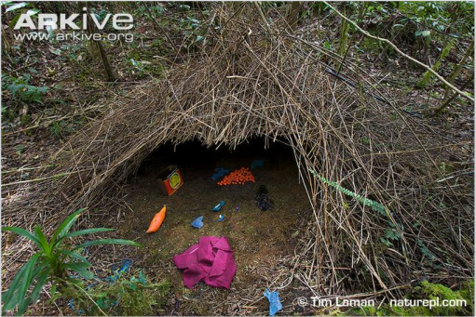
The Gift-Giver
Bowerbird
Male bowerbirds collect all sorts of trinkets - such as plastic rings, shiny tinfoil, and snail shells - to woo females into their elaborate bachelor pads, known as bowers. These bowers vary between species but some can be very large and elaborate. If the female likes what she sees then she will let the male with her.

Slide 8
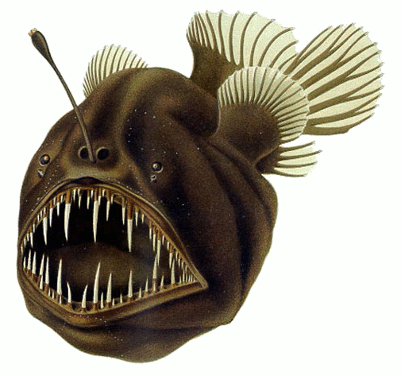
The Clingy Boyfriend
Anglerfish
Female anglerfish have the unique advantage of a built-in fishing rod. Seeking easy access to food, male anglerfish will use their teeth to hitch a permanent ride on a female -which basically makes them parasites, but also means she doesn’t have to look far for someone to fertilize her eggs when needed.

Slide 9
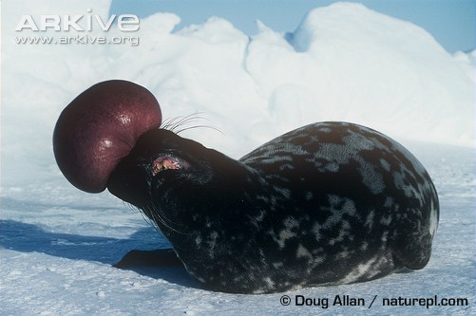
The Balloon Artist
Hooded Seals
To signal sexual availability, male hooded seals can inflate their uniquely elastic nasal cavities and membranes into what looks like a pink balloon. It also serves to communicate their health and superior status to both other males and females they are attempting to attract.
The pink nasal membrane, when shaken, is also able to produce various sounds and calls depending on whether the seal is underwater or on land.

Slide 10
Weird mating ballot
Vote for the weirdest mating ritual with a sticky dot!
Follow us RoyalSocBio
FB: Royal Society of Biology

