Slide 1
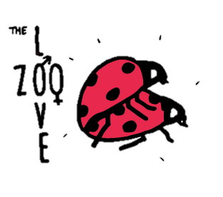
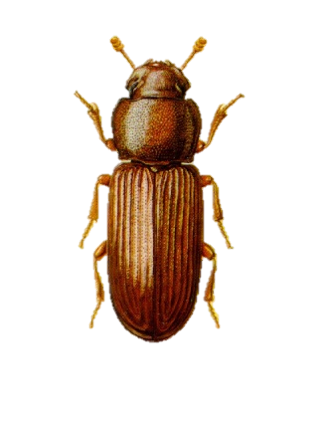
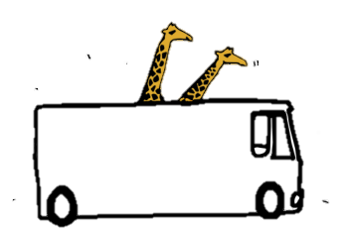
B
eetles
Tiger Beetles
Tiger Beetle males use their mandibles to latch onto females in order to mate. They then ‘ride’ on the females back for a long time after while the female violently struggles.
Beetles may display extremely intricate behaviour when mating. Pheromone communication is thought to be very be important in the location of a mate.
During this period, the males are vulnerable to predation, so why do they hold on for so long?
The answer lies with Sexual Selection.
The males are thought to be guarding the female, stopping other males meeting with them.
Conflict can play a part in the mating rituals of some beetle species such as burying beetles, where conflicts between males and females rage until only one of each is left. This ensures reproduction by the strongest and fittest.
Why do the females struggle so much?
Scientists believe that the female might be testing the male’s strength and endurance. Only those with superior strength and tenacity to hold on to the lurching female will successfully copulate and pass on their ‘top quality’ genes.
Check out our live specimens!

Slide 2
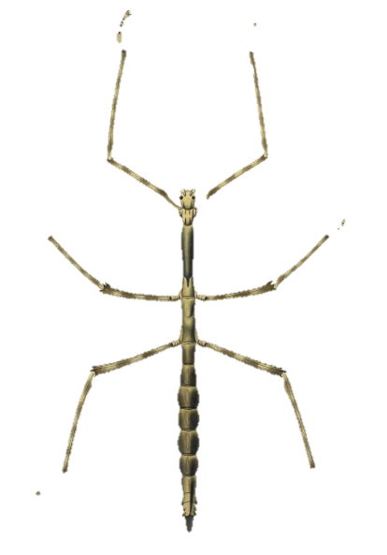
P
hasmids
Mating behaviour in stick insects is impressive because of the extraordinarily long duration of pairings. A record among insects, the stick insect Necroscia sparaxes, found in India, is sometimes coupled for 79 days at a time.
Why do stick insects mate for so long?
Theory1: Defensive Alliance
Theory 2: Mate Guarding
Extended pairing behaviour may have evolved as a way for males to guard females against sperm competition. Males of many species act aggressively and strike out against approaching males during mating.
When joined together, the pair is more difficult for predators to handle. Also, the chemical defences of the individual stick insects are enhanced when the two are paired. Females rate of survival during mating is much higher than when not
Check out our live specimens!

Slide 3
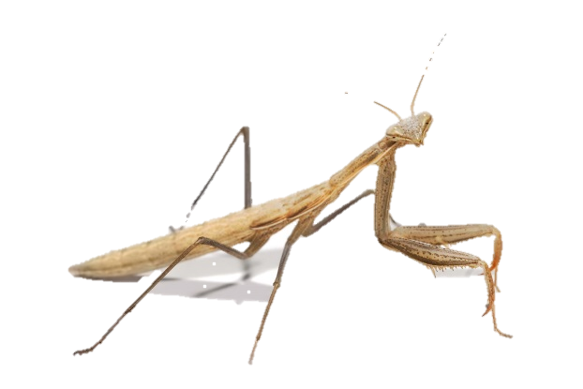
M
antids
Female mantids often use pheromones to attract males to mate with. Males are usually more attracted to healthy, ‘well-fed’ females. This is what is called an “honest signal”, as these females are more likely to produce a large healthy broods.
Painfully Attractive – Sexual Cannibalism
Males of some species of mantids would do well to approach their prospective partner with care, especially if she is hungry!
This is because, in many instances, the female of the species can be cannibalistic and will consume the male after they have mated. This behaviour is explained by the foraging strategy hypothesis: eating her mate gives the female increased nourishment, that helps her produce a larger healthy brood of eggs. Scientists have found that cannibalism is more common when the female is in a poor condition.
Check out our live specimens!

Slide 4
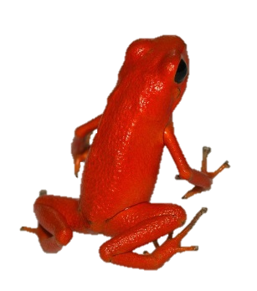
F
rogs
Hoping Hormones
Many frog species gather into large breeding groups once or twice per year. The male frogs attract females with their calls or ‘croaks’ and can be very aggressive during this period; females by comparison remain calm throughout.
Male frogs characteristic ‘croak’ is believed to be controlled by sex hormones.
Endocrinologists (scientists that study hormones and pheromones) are able to work out the sex of a frog by analysing their faeces and measuring levels of the hormones progesterone, oestradiol and testosterone. This is useful when studying endangered species like poison dart frogs, as they don’t have to be caught.
Male frogs have different types of calls. First they will use an ‘advertisement call’ that communicates species type, sexual readiness and size. Once a female seems interested, they will switch to a ‘courtship call’, designed to get the female in the mood to mate!
Males have developed vocal sacs that enable louder calls as a direct result of sexual selection – evolutionary adaptations that an individual’s chances of successfully mating and reproducing.
In some species, Female frogs have also show preference for male physical traits, like forelimb and thumbpad size. are important during mating. As a result of strong sexual selection these traits are bigger in males. Some species also show a preference for certain colours.
Check out our live specimens!

Slide 5
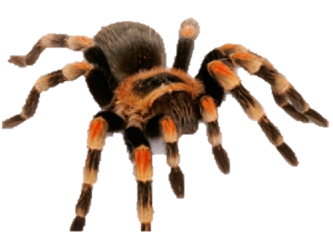
S
piders
The Moth Pheromone Trap
Male – Male Competition
Bolas spiders lure moths to their doom by mimicking their sex pheromones. It slings a single line of silk across a gap then waits for male moths to come in search of female company.
In some species being larger is beneficial so that you can out muscle and fight off competitors. Sexual selection has also lead to males with larger mouthparts to fight with.
In other species, being small is more beneficial, as smaller males are faster climbers and are able to win the race to a female.
The Goliath Bird-eating Spider
Males will come to the entrance of the female's burrow and try to entice her out. He will use his mating hooks to restrain her fangs while he tries to mate with her. Afterwards he has to make a fast getaway so as not to be injured or killed by the female. Only around 50% survive unharmed!
Mate Choice
Mate choice is typically displayed by females, but males can be choosy as well.
Courtship displays are common. These displays are signals that are used to attract the opposite sex and indicate an individuals viability
Check out our live specimens!

Slide 6
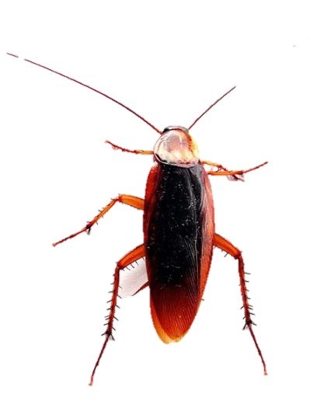
C
ockroaches
Chemical Signals
Chemical signals are essential in all cockroach sexual behaviour. Pheromones released by one partner, normally the female, will attract mates from great distances and an aphrodisiac sex pheromone, produced exclusively by males initiates mating.
The female cockroach judges the quality of the pheromone as an indicator of the male’s quality. To a female cockroach, a higher quality pheromone means a superior male.
Hissing Wars
The male Madagascar hissing cockroaches will ‘hiss’ by forcing air through spiracles (small holes used for breathing) to both attract females and also in altercations with other males, to determine dominance. The looser of the hissing battle will back down to avoid a fight.
Check out our live specimens!

Slide 7
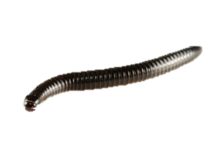
M
illipedes
During mating season, males and females are brought together by pheromones emitted by the male. However, these are only thought to effective at short distances.
Millipedes show a diversity of mating styles and structures. In the basal order Polyxenida, males deposit spermatophores that are subsequently picked up by females. In all other millipede groups, males possess one or two pairs of modified legs called gonopods which are used to transfer sperm to the female during copulation.
Millipede mating involves the male, walking along the females back and stimulating her with rhythmic movements of his legs.
Females lay between ten and three hundred eggs at a time, depending on species, fertilising them with the stored sperm as they do so. Many species simply deposit the eggs on moist soil or organic detritus, but some construct nests lined with dried faeces, or create silk cocoons.
Check out our live specimens!

Slide 8
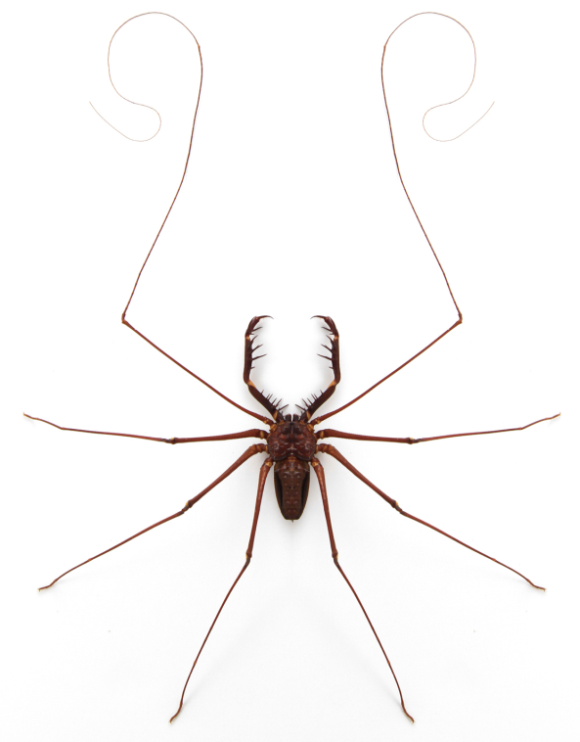
W
hip
Scorpions
Guide to Courtship for Males
1. Hide your sperm – place your sperm packet (spermatophore) somewhere safe where no one else can find it.
2. Find a female – find yourself a female that might be interested in your spermatophore.
3. Dance! – the courtship dance with your chosen female is an important stage as it helps communicate that you are a potential mate and not a meal!
4. Lead her to your sperm – After the dance take the female back to your hidden spermatophore. When the female sees it, she will hopefully place it into her reproductive opening. The eggs stay there until they are ready to hatch.
Check out our live specimens!

