Slide 1



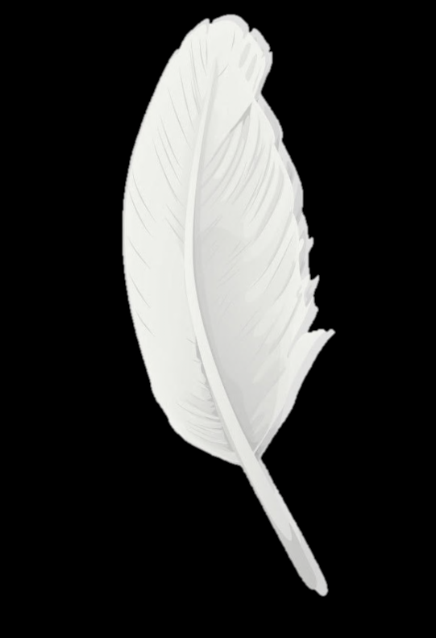
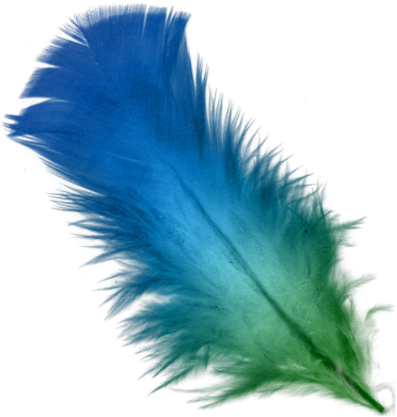
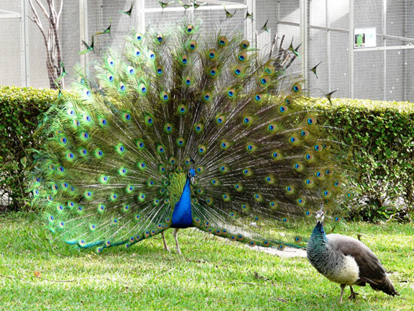
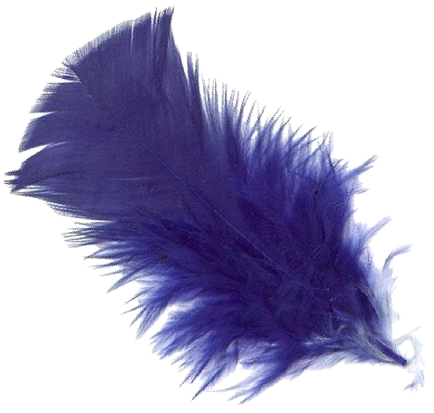
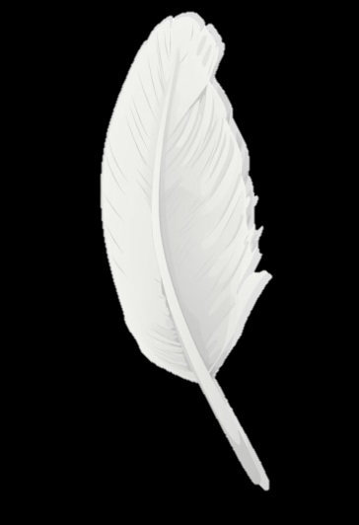
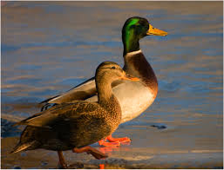
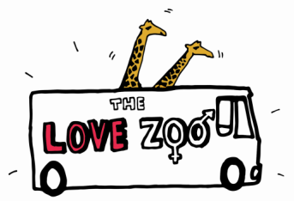


L VE-birds
In lots of bird species the males and females look different to each other – this is called
sexual dimorphism.
Sexual dimorphism in birds and other animals is due to differences in male and female hormones.
Male birds often have brightly coloured feathers to make them more attractive to female birds; females have more dull-coloured feathers.
Male birds’ colourful feathers allow them to demonstrate their ‘fitness’ as a mate to female birds. They are often bigger and also behave differently to female birds.

Slide 2
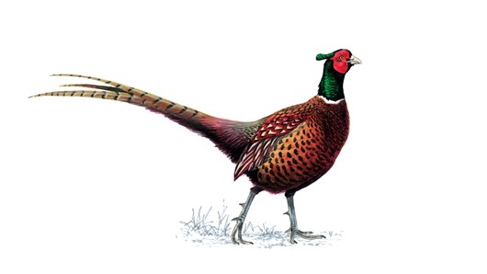
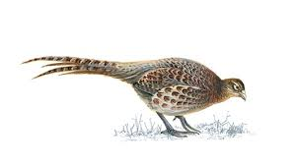
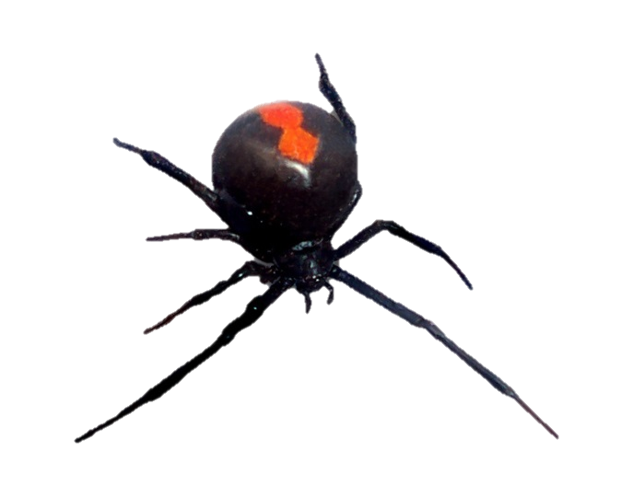
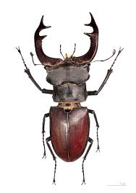
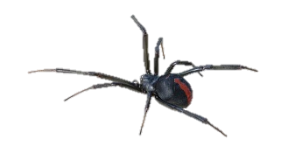
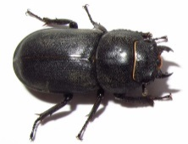

SEXUALDimorphism
Dimorphic is a word describing how males and females of the same species are very different to each other.
Sexual dimorphism is where there are obvious differences between the male and female of a particular species

