Slide 1

Identifying and Understanding the Barriers to Effective Transition
School of Life Sciences - Dr Leanne Williams

Slide 2
What do we offer?
Entry 2016 Offer for all degrees will be AAB - ABB
  ABB likely for students with 2 or more science A-levels
Biological Sciences
  A broad-based degree which you shape to fit your interests
Biochemistry
  A detailed understanding of life at the molecular and cellular level
Biomedical Science
  A focused degree on human health and disease
Medical Microbiology and Virology
  Studying how the microscopic world affects human health
Master of Bioscience courses (AAA-AAB)
  Available from 2015
Notes:
2

Slide 3
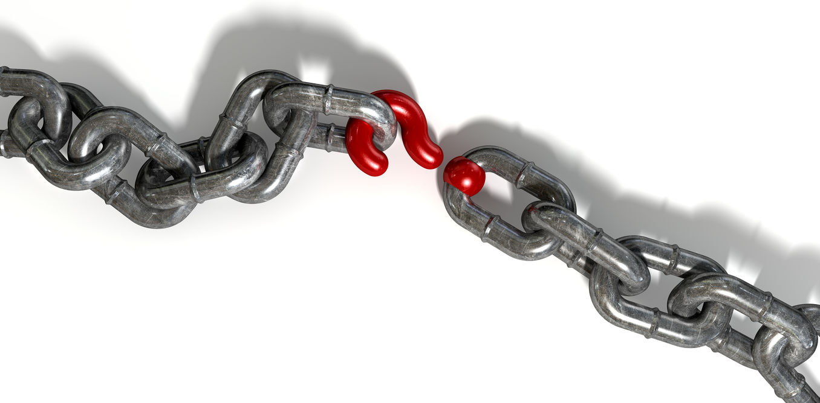
What’s the missing link?

Slide 4
Student opinion -The headlines

Slide 5
How well did your pre-University qualifications prepare you for learning at University?
Extremely well
Quite well
Neutral
Not very well
Not at all
0%
10%
20%
30%
40%
50%
60%

Slide 6
Are lectures more difficult to learn from than lessons at school/college?
Much more difficult
Somewhat more difficult
About the same
Somewhat less difficult
Much less difficult
0%
10%
20%
30%
40%
50%

Slide 7
Based on your lab experience from school/college were you well prepared for Year 1 practicals?
Extremely prepared
Somewhat prepared
Neutral
Under prepared
Completely unprepared
0%
10%
20%
30%
40%

Slide 8
Is there anything that you wish you had learned better before coming to University?
Note taking in lectures
Time Management
Better revision strategies
Being better prepared
Learning from lectures
More emphasis on quant skills
Be less spoon-fed in school

Slide 9
Which skills do you wish you had learned better at school/college?
Answer choice | Response
Structuring a lab report | 65%
Data analysis | 54%
Taking effective notes | 53%
Designing an experiment | 47%
Developing a scientific writing style | 47%
Data generation and presentation | 46%
Structuring an essay | 38%
Lab practical skills | 35%

Slide 10

Personal and social characteristics/skills
Academic intelligence

Slide 11
What have we done?
In terms of transition from school/college to Year 1 = Pre-arrival website
Welcome videos HoS, DUGS and me.
Lab skills – instructional videos (RLOs)
  Basic techniques
Study skills
  Mini lecture – note taking/extracting info.
  Data handling (Student zombie plague)
  How to display data
http://www2.warwick.ac.uk/fac/sci/lifesci/study/ug/welcome/

Slide 12








Science 101: Enabling success
Science 101 - non-credit rated optional skills-based module for UG students
http://moodle.warwick.ac.uk/course/view.php?id=12622

Slide 13
Which ‘Science 101’ session did you attend?
Learning from lectures
Lab reports I
Preparing for exams
Biological terminology
Essay writing
Posters and presentations
Lab Reports II
0%
10%
20%
30%
40%
50%
60%
70%
80%
90%
100%

Slide 14
Structured academic and pastoral tutorial programmes
Academic tutorial every week in Year 1
  Small group teaching, independent and group assessment, predominantly underpins lecture content.
Every other week in year 2 & 3
  Research led, paper deconstruction, critical evaluation
One pastoral session every term – personal and social skills

Slide 15
Laboratory practical & written skills.
Generation of a structured lab book for 12 A-level practicals (Guidance, EGs and a CPAC tracker).
Instructional videos embedded in interactive platforms – Articulate
A move away from simply ‘recipe-following’ and generating of data to write up a lab report.
Practical skill assessment

Slide 16
From the choices below; in your experience which one is the most important for a positive First year at University.
Fitting in and making friends
Adjusting to University teaching methods
Developing independence and academic confidence
Developing academic and prof. skills to increase employability
0%
10%
20%
30%
40%
50%
60%

Slide 17
Thanks to:
John Harvey and Hannah Pape – Transitions website and resource development.
Dr Annunziata Videtta – Science 101.
Kate Mawson – Liaison with schools and development of A-level lab book

