Slide 1
Mathematical Skills in the Transition from School into Higher Education
Dr Jenny Koenig
Lucy Cavendish College, University of Cambridge and St Ivo School

Slide 2
Biotechnology and Biological Science Research Council 2016
“As bioscience becomes more quantitative there is also an urgent need to raise the mathematical and computational skills of biologists at all levels”
http://www.bbsrc.ac.uk/news/planning/strategy/theme-one/

Slide 3
Association of the British Pharmaceutical Industry (ABPI)
Recommendation 3:
The pipeline for the development of appropriate mathematical skills must be considered. This extends from opportunities for students to study maths alongside science subjects post-16, through universities putting increased emphasis on maths in bioscience courses, to raising awareness and uptake by UK and EU graduates of Masters and PhD level training in statistics, data mining, mathematical modelling and related disciplines.
Bridging the skills gap in the biopharmaceutical industry: Maintaining the UK’s leading position in life sciences, November 2015.
http://www.abpi.org.uk/our-work/library/industry/Documents/Skills_Gap_Industry.pdf

Slide 4
Vision and Change in Undergraduate Education: A call to action. AAAS. (2011).
“The application of quantitative approaches (statistics, quantitative analysis of dynamic systems, and mathematical modeling) is an increasingly important basic skill utilized in describing biological systems
Ability to use modelling and simulation - Biologists must understand both the advantages and the limitations of reductionist and systems approaches to studying living systems.”
http://visionandchange.org/finalreport/

Slide 5
Curriculum mismatch
Affective domain

Slide 6
Numeracy
GCSE: C and below
(16 yrs)
Curriculum mismatch
Algebra, trigonometry, scientific notation
GCSE: A*,A
(16 yrs)
Sometimes includes statistics
Mostly B or C at GCSE
A level
Exponential eq’n
Logarithms
Calculus
(18 yrs)
~60-70%
~30-40%
Bioscience BSc

Slide 7
Numeracy
GCSE: C and below
(16 yrs)
More maths in science GCSE
Algebra, trigonometry, scientific notation
GCSE: A*,A
(16 yrs)
Sometimes includes statistics
A level
Exponential eq’n
Logarithms
Calculus
(18 yrs)
More maths in science A levels
Core Maths Problem-Solving
(18 yrs)
Bioscience BSc

Slide 8
New maths content in Science GCSE:
Sampling
Mean, mode and median
Order of magnitude calculations
Solve simple algebraic equations
Understand that y = mx + c represents a linear relationship
Draw and use the slope of a tangent to a curve as a measure of rate of change
More maths in science GCSE
More maths in science A levels
New maths content in Science A levels:
Use appropriate units in calculations
Use exponential and logarithmic functions
Identify uncertainties in measurements
Bioscience BSc

Slide 9
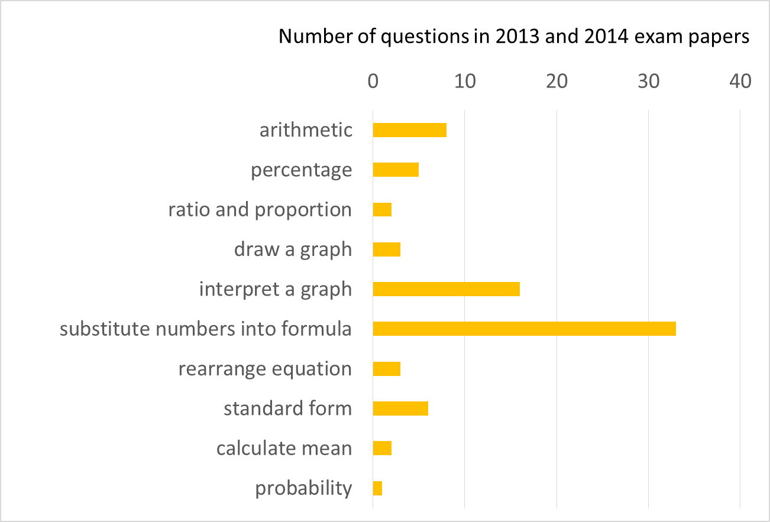
Observations of secondary school maths in science:
Reliance on procedural approaches as response to assessment questions which are highly scaffolded and predictable (focus on small number of mathematical topics).

Slide 10
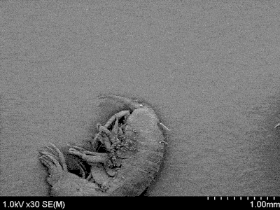
Observations of secondary school maths in science:
Types of data
Categorical e.g. nominal or ordinal
Χ² test
Continuous e.g. ratio or interval
t-test
2. Lack of connections between maths and science → gaps
3. Lack of fluency in use of negative powers and inability to visualise size.
Length in metres
1 x 10⁻³
5 x 10⁻⁵
1 x 10⁻⁶

Slide 11
Affective domain
“fear of maths”, “maths-phobia”
“treat maths as some kind of mystical dark art, sent to terrorise biologists”
“the key difficulty is not so much lack of knowledge as lack of confidence”
“the maths content of a Biology degree comes as quite a shock…”
“when they see the application for themselves, many do shift their opinion and attitude towards mathematics”

Slide 12
Solutions

Slide 13
Drop-in Support – The SIGMA network is for people who run maths support centres
www.mathcentre.ac.uk – website with resources contributed by the community.
Solutions

Slide 14
www.mathcentre.ac.uk
Search for Essential Mathematics for Biologists, Medics and Vets
Audiovisual tutorials
Textbook pages
Practice and test questions written in the Numbas open source authoring system

Slide 15
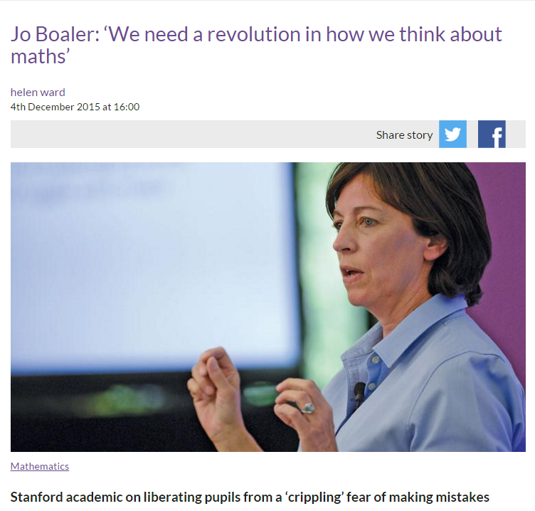
“We need to free our young people from the crippling idea that they must not fail, that they cannot mess up, that only some students can be good at maths and that success should be easy and not involve effort,”
Solutions

