Slide 1
How to tackle the math problem?
Pam Dunn
Medical Education Manager
Harrogate and District NHS Foundation Trust

Slide 2
Background
Clinical and Analytical Biochemistry module exam. (stage 2, Biomedical Science programme)
25% of cohort obtained 0 marks for a mole/mass/volume calculation
Practical interventions

Slide 3
Who?
Up to approximately half the cohort
Most prevalent in those who had not taken ‘A’ level chemistry
Least prevalent in those on Clinical Science programme (high tariff entry)

Slide 4
Why?
Self-selection?
Lack of secure understanding early in maths learning pathway?
Motivation/ avoidance?
previous learning experiences?
Time-lapse since maths learning?

Slide 5

calculations
This Photo by Unknown Author is licensed under CC BY-NC-ND

Slide 6
Interventions: avoidance / motivation
Explicit expectations at beginning of module
Practice assessments to self-administer and mark spaced throughout module
Continued emphasis that end of module assessment will include calculations

Slide 7


Interventions: avoidance / motivation
This Photo by Unknown Author is licensed under CC BY-SA-NC
vs
This Photo by Unknown Author is licensed under CC BY-ND

Slide 8
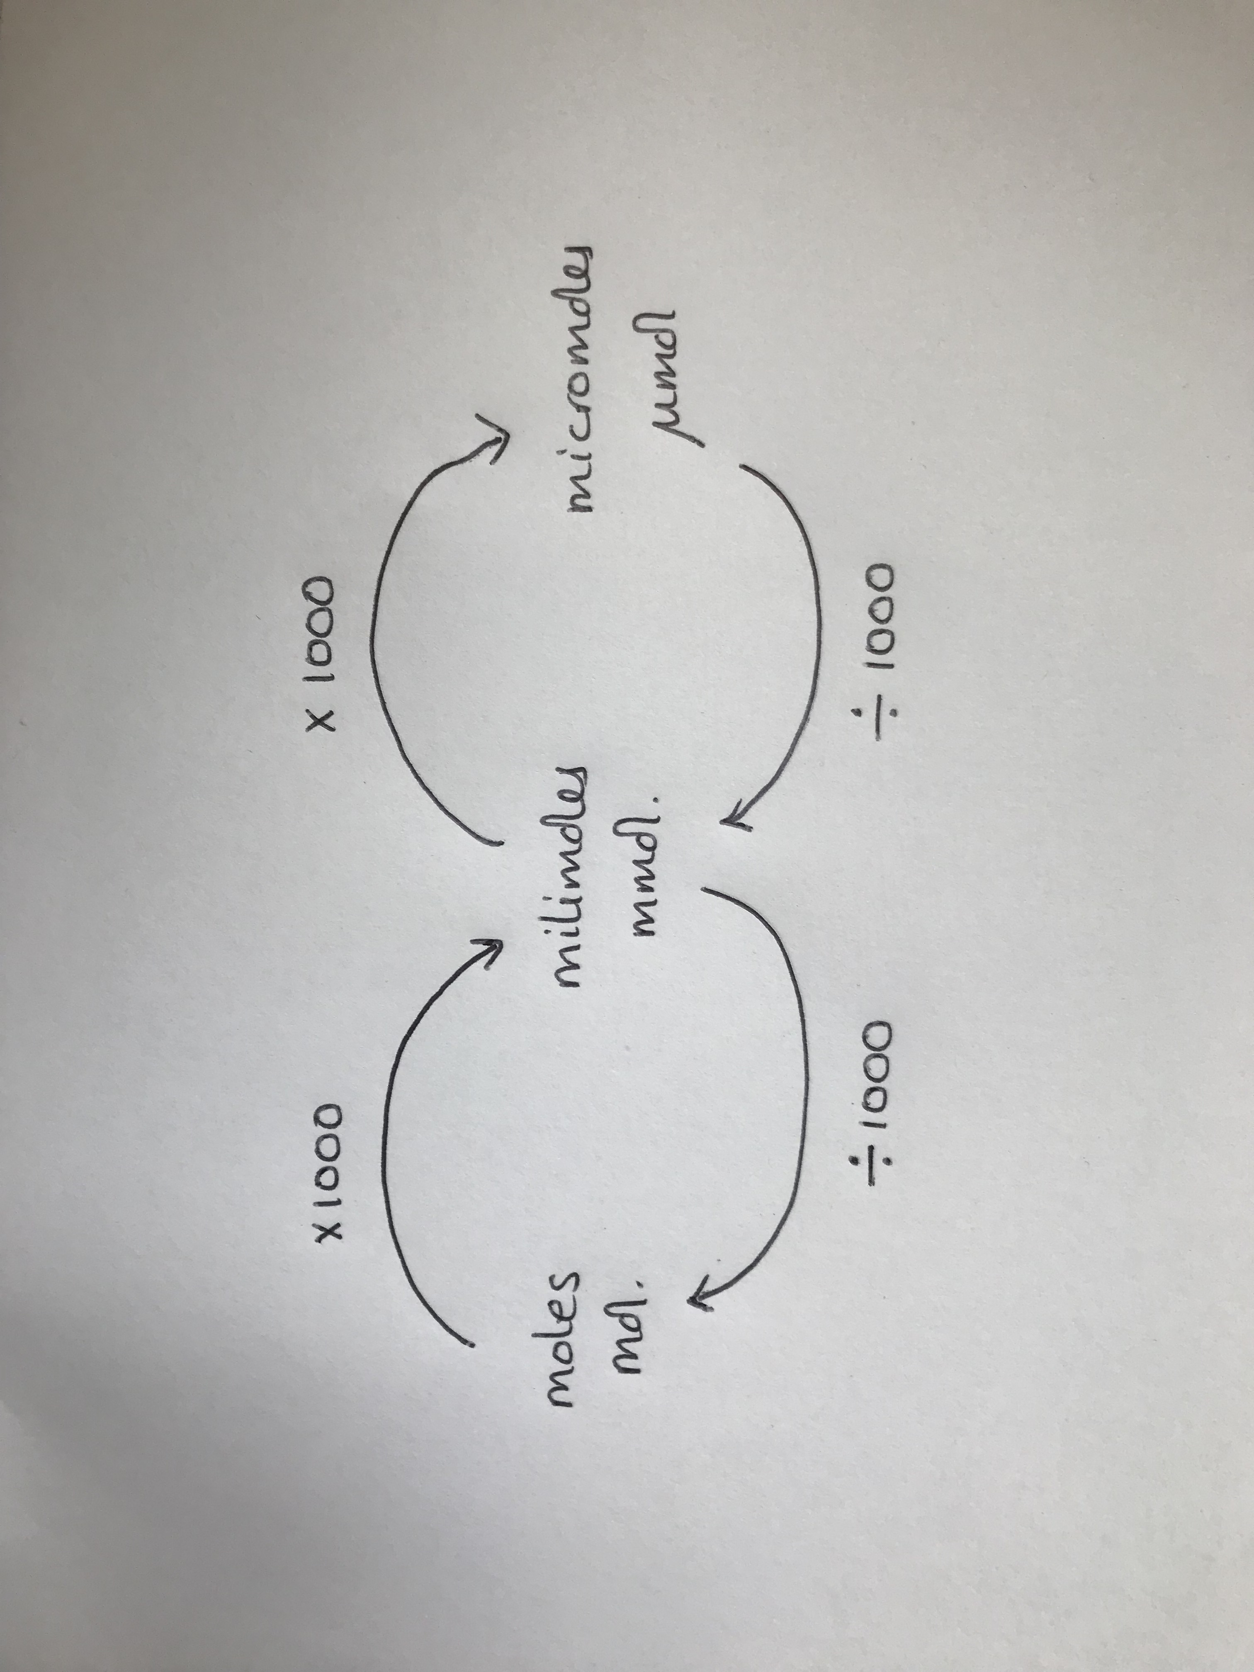
Interventions:
Practical materials to support conceptual understanding

Slide 9
Interventions:
Structured learning and materials
Structured workshop questions with opportunity for developing mathematical technique
Q1 You have a 2M solution of sodium chloride. How many moles are there in:
(a) 2 litres
(b) 500 mls?
(c) 300 mls ?
(d) 1245 mls?

Slide 10
Interventions:
Structured learning and materials
Q1 You have a 2M solution of sodium chloride. How many moles are there in:
(a) 2 litres
2M = 2 moles per litre
So moles in 2 litres = 2 moles x 2 litres
(b) 500 mls?
2 M = 2 moles per litre, 500mls = 0.5 litres
So moles in 2 litres = 2 moles x 0.5 litres
(c) 300 mls ?
(d) 1245 mls?

Slide 11
Interventions: supporting conceptual understanding
Pseudohyponatraemia
Patients with very high levels of triacylglycerol in their blood sometimes get an artificially low serum sodium level when measured by ‘indirect’ Ion-selective electrode. Why?
(‘indirect ISE’ are those in which the serum is diluted in buffer before being measured by the electrode)

Slide 12
Outcomes
Improvement in calculation outcomes, though varied by cohort
Consistently improved module feedback results
Some dramatic impact for some individuals
Moves towards development of a programme-wide strategy

Slide 13
Observations/suggestions?

