Slide 1





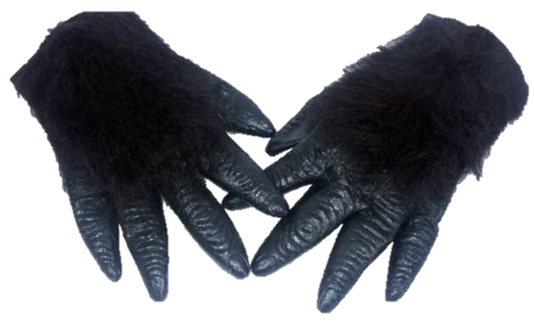
GROOM A GORILLA!!
I am Sylvester the Silver-back Gorilla
Please groom me!
How fast can you remove the flies in my fur?

Slide 2
GROOM A GORILLA!!
I am Sylvester the Silver-back Gorilla
Please groom me!
How fast can you remove the flies in my fur?

