Slide 1
MBP² , Authentic Biology and IRIS
Dr Dave Colthurst
Simon Langton Grammar School for Boys
Canterbury, Kent, England.

Slide 2
Plan for this talk
Explain how MBP² began and then grew
Introduce Authentic Biology – a National programme of school research projects
Introduce IRIS, the Institute for Research In Schools

Slide 3
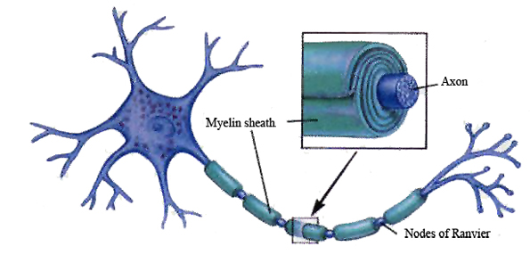
The Myelin Sheath
Insulating layer around the axon of nerve cell in mammalian CNS
Mostly composed of lipids, also contains proteins
Second most abundant protein is Myelin Basic Protein (MBP)
Laid down by oligodendrocytes

Slide 4
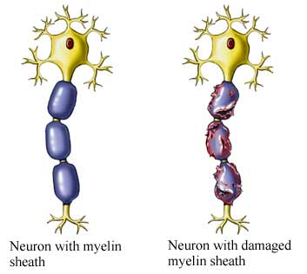
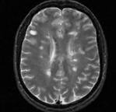
Demyelination
Damage to the myelin sheath results in reduced nerve function
Regions of damage can be imaged by NMR as a plaque or sclerosis
If you have a lot of damage, you have Multiple Sclerosis

Slide 5
What is MBP²?
Running for seven years
Funded entirely by the Wellcome Trust
Supported by the University of Kent
Students carrying out original research into MBP – implicated in development of MS

Slide 6
What is MBP?
MBP is a “fragile” protein – no fixed structure
Subject to multiple post-translational modifications
Phosphorylation happens and causes changes to the structure of the protein
Evidence to suggest this triggers part of the auto-immune response

Slide 7
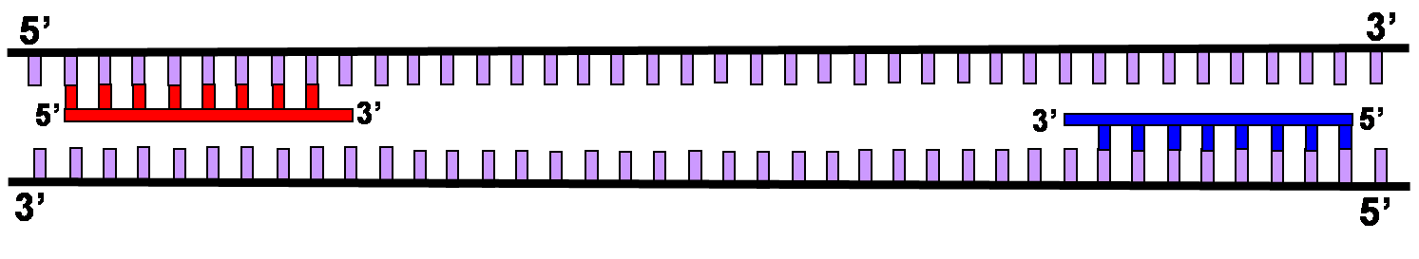
Cloning the Human MBP gene
We designed PCR primers for the human MBP gene.
We incorporated a Hind III cut site at the N-terminus of the MBP protein
We added an octa-His tail to the C-terminus and added an EcoRI cut site
We sub cloned this PCR product into pYES2 to create pSLB1

Slide 8
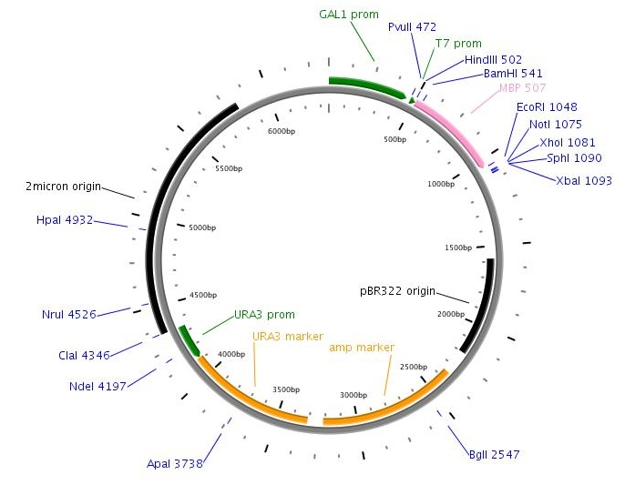
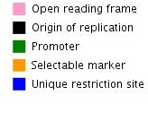
pSLB1

Slide 9
Expression of MBP in yeast
Adding the sugar galactose to the growth medium, switches on the Gal-promoter
This transcribes MBP mRNA
The mRNA is then translated to make the human protein
Due to the similarities between yeast and human biochemical pathways, the MBP is then modified

Slide 10
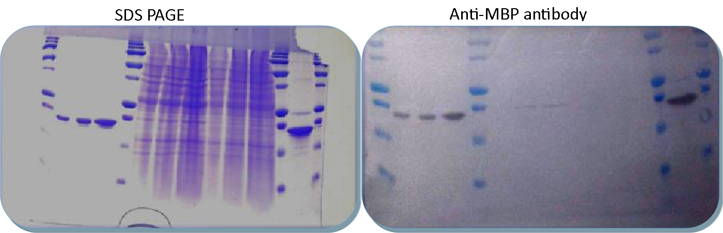
Identification of human MBP in yeast
Protein gel shows the bovine MBP control and 5, 10 and 20µl of two yeast lysates
The western blot is developed with anti-MBP antibody and shows the presence of Human MBP in the yeast cells

Slide 11
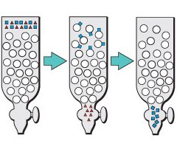
How do you separate MBP from all the yeast proteins?
Nickel-sepharose chromatography
Load a yeast lysate onto the column, wash away any proteins that do not bind, leaving MBP stuck to the column, then wash this off to collect pure human MBP

Slide 12
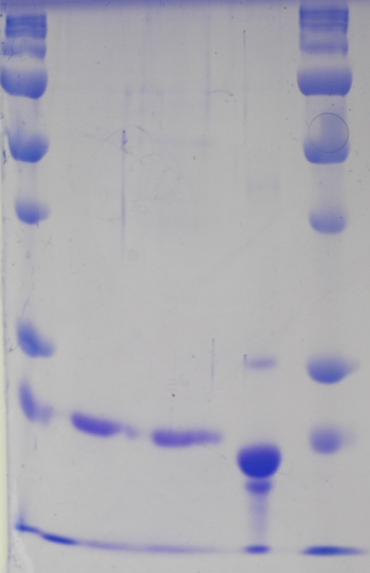
How do we identify the MBP?
We run samples from the column on SDS-PAGE gels. These separate proteins by molecular weight, small proteins run quickly, large proteins are held back in the gel.
We can visualise the proteins by staining them with coomassie blue

Slide 13
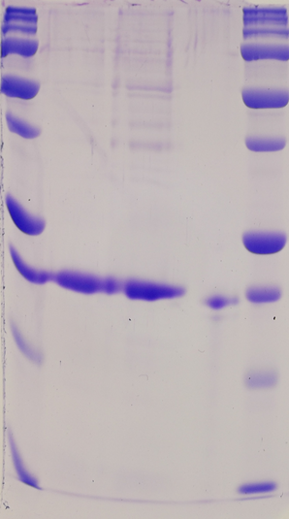
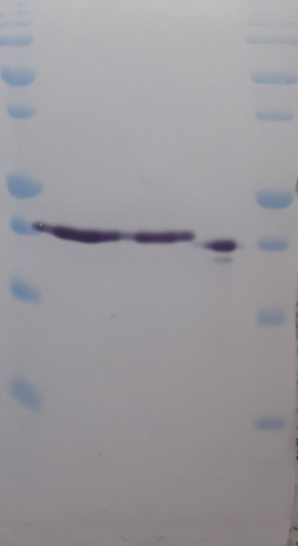
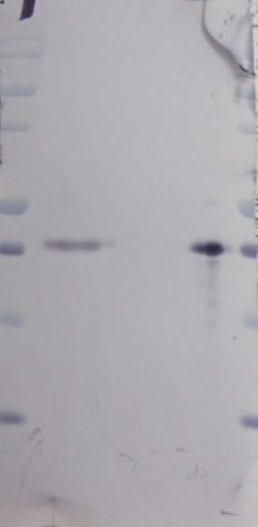
Detection of phosphorylation of MBP
A specific anti-MBP antibody clearly react with our protein showing that it is in fact MBP. The fourth track on the gel is bovine MBP, used as a positive control.
This second blot was developed using an antibody specific for MBP phosphorylated on Threonine-98.

Slide 14
Future work
We now have several forms of the human MBP protein, but no idea of the significance of any of these
We want to develop a binding assay between MBP and proteolipid protein (PLP)
We would aim to use this to identify different affinities for MBP and PLP depending on which PTM’s are present – possibly gaining some insight into in-vivo behaviour

Slide 15
What were the benefits for the students?
The number of students studying Biology at A-level doubled (90 to 180).
Around 100 of these students were involved in the project each year
Around 65% of our students apply to study STEM-based subjects at university
They are applying to, and getting offers from top-flight universities (Russell Group)
The range of subjects being studied has broadened
Leadership and public speaking skills

Slide 16
What were the benefits for the staff?
Engaging in exciting research (one of the reasons they studied science in the first place)
Developing new practical skills
Increased confidence in teaching molecular techniques
Strong links to the curriculum, reinforcing the theoretical work

Slide 17
What were the benefits for the University?
A long-term public engagement activity
Opportunities for staff to see what teaching in a school might involve
A project that delivered measurable outcomes in terms of the quality and impact of an out-reach activity
Fun – all the staff involved have said how much they have enjoyed their involvement

Slide 18
Authentic Biology
The Wellcome Trust wanted to see if MBP² could be replicated in other schools
We were encouraged and guided to make an application for a Society Award
We recruited four more universities across the country
Each university identified a school they wanted to work with
The school was then given an opportunity to be involved in deciding what research topic they wanted to study

Slide 19
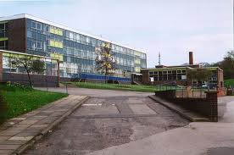
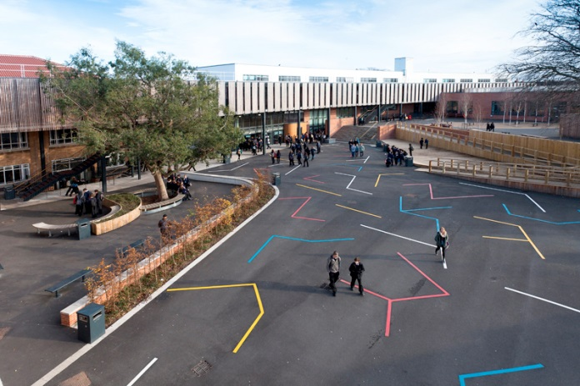
Four more schools involved
Tapton School, Sheffield
Cotham School, Bristol
Working with The University of Sheffield
Looking at genes associated with heart disease
Using Zebra fish embryos and in situ hybridisation to look for genes affecting heart structure
Working with the University of Bristol
Looking at genes associated with inflammation and cancer
Also using Zebra fish and bio-informatics to identify and study genes linked to cancer

Slide 20
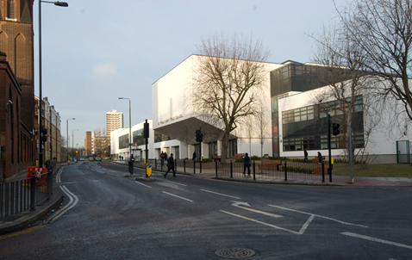
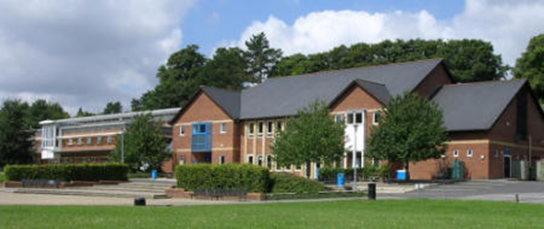
St Paul’s Way Trust School, Tower Hamlets
Peter Symonds College, Winchester
Working with Queen Mary University of London
Over 85% of students are of Bangladeshi origin, they were determined to study Diabetes in their community
They are using PCR to identify variants of the FTO gene in processed blood samples taken at the local NHS clinic
Working with the University of Southampton
Students undertake practical EPQ’s using techniques supplied by the University
They are studying aspects of development in drosophila and C. elegans and retinal cells.

Slide 21
Initial grant
The first Society Award allowed us to establish these four new research projects, as well as continuing MBP²
It ran for three and a half years
The grant paid for a half day per week for a teacher and a technician in each school
It allowed an initial £6,300 equipment budget per school
It gave £2,500 per year consumable budget to each school

Slide 22
Annual Symposium
The grant also covered the cost of running an annual Research Symposium
Students from each school present their work as short talks and also on posters
Invited guests give key-note lectures, e.g. Lord Robert Winston, Professor Jeremy Fararr
The first symposium was held at QMUL, all subsequent symposia have been held at the Wellcome Trust Headquarters in central London

Slide 23
Authentic Biology – part 2
In September 2015, we started a new phase of the project
A second award led to a further expansion, with two new schools added for a two year period

Slide 24
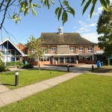
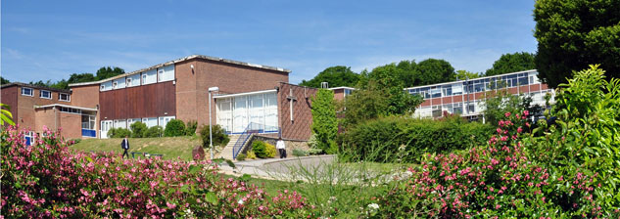
The new schools
Archbishop’s School, Canterbury
Parkside Academy, Cambridge
Working with the University of Kent
Working on a project called “Bird Beats” they are purifying and examining myosin from the heart tissue of birds ranging from a humming bird to an ostrich to see if they can find structural differences that explain the different heart rate in these birds
Working with the University of Cambridge
Looking at bacteriophage, they have isolated phage form the River Cam, purified the DNA and sent it away for DNA analysis

Slide 25


Slide 26
Aims
Nurture the potential and ability of young people to contribute to the scientific community
Increase uptake of post 16 maths, science and technology courses
Increase applications for STEM subjects at university, especially with girls
Enhance teachers’ expertise and job satisfaction and so retain teachers and recruit more to the profession
Engage Universities and Industry in sustained interaction with schools
Develop communication, creativity, critical thinking and collaboration as essential skills for young people

Slide 27
Institute for Research in Schools
CERN@school – particle physics
Authentic Biology – biomedical science
Other projects - space physics, transport, marine research, astronomy and materials science
We work on making access to data and research projects available through resources, training and direct support

Slide 28
IRIS Trustees
Trustees of the Institute for Research in Schools
Professor Steve Rose (Chair) Imperial College and University of Oxford
Humphrey Battcock Managing Partner, Advent International plc
Dr Matthew Baxter Headteacher, Simon Langton Grammar School for Boys
Professor Sir Leszek Borysiewicz Vice-Chancellor University of Cambridge
Professor Dame Julia Goodfellow Vice-Chancellor University of Kent

Slide 29
www.researchinschools.org
contact
beckyparker@researchinschools.org
@ResearchInSch

