Slide 1
Barrier Crossing with Technology
Using Augmented Reality to teach the Chemistry of Biomolecules

Slide 2
How Technology Impacts Learning
Comprehension of the 'microworld' in science, especially chemistry can be challenging for students
Technology is becoming accepted as a central part of chemical education (Seery & McDonnell, Chem. Edu. Res. Pract., 2013)
  videos of reactions
  simulations
Generally, technology becoming adopted across education
  e.g. Kahoot, Poll Everywhere, Pebblepad, VLEs

Slide 3
How Technology Impacts Learning
technology can alleviate cognitive load
  significant for novice learners with new material
  e.g. online homework with step-wise manner
use of simulations lead to higher achievement
  simpler simulations followed by more complex
  learning through guided student inquiry
tools such as augmented reality (AR) can allow inquiry-based exploration of micro-worlds in science
Cai et al., Comp. Human Behav., 2014
Sweller, Handbook of Research on Educational Communications and Technology, 2008
Mayer, Cambridge Handbook of Multimedia Learning, 2005
Garratt, Univ. Chem. Edu., 1997

Slide 4
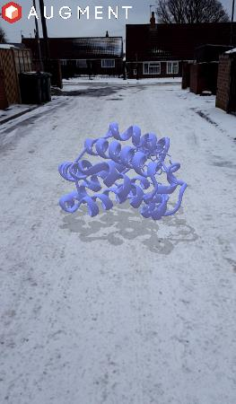
What is augmented reality?
Images (computer-generated) superimposed on our reality
Interactive 3D images
Augments the environment around us
  Placement of objects
  An interactive extra dimension
Unlike VR, no headset needed
  Smartphones
  Tablets
  PCs
Myoglobin
in the snow
Notes:
Images, typically computer-generated, superimposed on our reality, our view of the world
Placement of objects – e.g. if you want to remodel your kitchen, there are tools such as AUGMENT that allow you to envisage what the new one will look like in your actual kitchen

Slide 5
From the lab…
Data visualisation tools used extensively in our research
  Visualising patterns in complex data
  Modelling complex biological systems
  Viewing interactions and movement of biomolecules
Technology enables researchers to examine complex detail easily
https://sketchfab.com/models/cd46eadc56654e259cd9020ce4fb74d4
Notes:
Link to sketchfab structure of hemoglobin

Slide 6
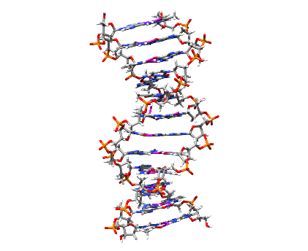
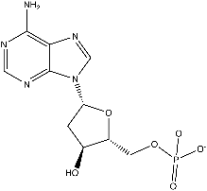
to teaching…
Students can struggle linking the microscopic detail → biological systems
Simple structure
Complex structure
Noncovalent interactions
Nucleotide: deoxyadenylate
DNA

Slide 7

Let’s have a go!
Handouts under your chair
Download and install the Augment app (iPhone or Play Store)
Scan the image on the handout
Press the ‘3D’ button to interact with the molecule alone

Slide 8
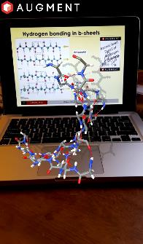
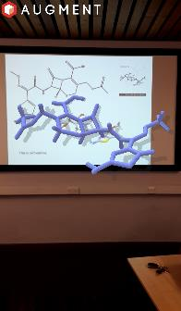
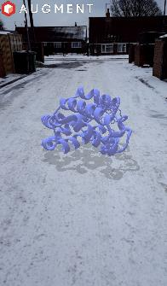
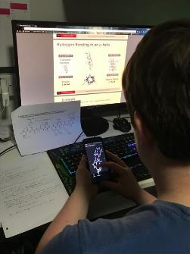
Assist with understanding complex structure
Biomolecules and biomolecular interactions
Investigate underlying stereochemistry and non-covalent interactions
Free app used through scanning ‘tracker’ images
Scan computer
screens
Scan lecture
slides
View in any
environment
Enhance study

Slide 9
AR was introduced in Biomolecules & Cells module
Used to facilitate discussions
Questions posed that prompted students to use AR with a focus
    e.g. identifying parallel and anti-parallel hydrogen patterns in β-sheets
Student Feedback
Easy to use (simply scan an image with phone/tablet)
Fun!
Easier to engage with material through individual device
Encouraged sharing and team work in small groups
Valuable in independent study

Slide 10
Impact of AR on Learning
AR can be an equalizer
Research has shown:
  larger influence on low-achieving students
  useful remedial teaching tool
  reduced memory decay after class
  students positively responded
  enjoyed exploration of chemistry with AR
Using AR as an inquiry-based learning tool has significant supplemental learning effects
learning chemistry
felt
rewarding
Cai et al., Comp. Human Behav., 2014
Nunez et al., New Aspects Eng. Edu., 2008
Iordache et al., Studies Inform. Control, 2012
Notes:
Technology can enable us to design interactive and collaborative activities to foster communities of inquiry where students discover, reflect on and evaluate knowledge together (Marzano, 1998; Garrison et al. 2010). Moreover, technology can be an equaliser with approaches, such as augmented reality, showing that even low-achieving students are not lost when educators learn to use learning technologies effectively (Cai et al, 2014).
Marzano, R. J. (1998) A theory-based meta-analysis of research on instruction. Aurora, CO: Mid-continental Regional Educational Laboratory.
Cai, S., Wang, X. and Chiang, F-K. (2014), A case of augmented reality simulation system application in a chemistry course. Computers and human behavior 37, 31-40.
Augmented reality was also used in plenary sessions to assist students with the challenge of linking basic chemistry to large biomolecules (E14) and was made accessible through both the VLE and handouts (E15) for students to use during independent study periods (Figure 1) (K4). Feedback from my T03 observation confirmed that using such technologies did create an interactive, supportive and engaging environment (E20). However, through designing material that can be accessed in many formats, I extend this experience and support beyond the classroom.

Slide 11
Try it yourself…
J B Priestley Computer Lab (room 01.53) after lunch
  Hands on tutorial to create your own AR models

