Slide 1
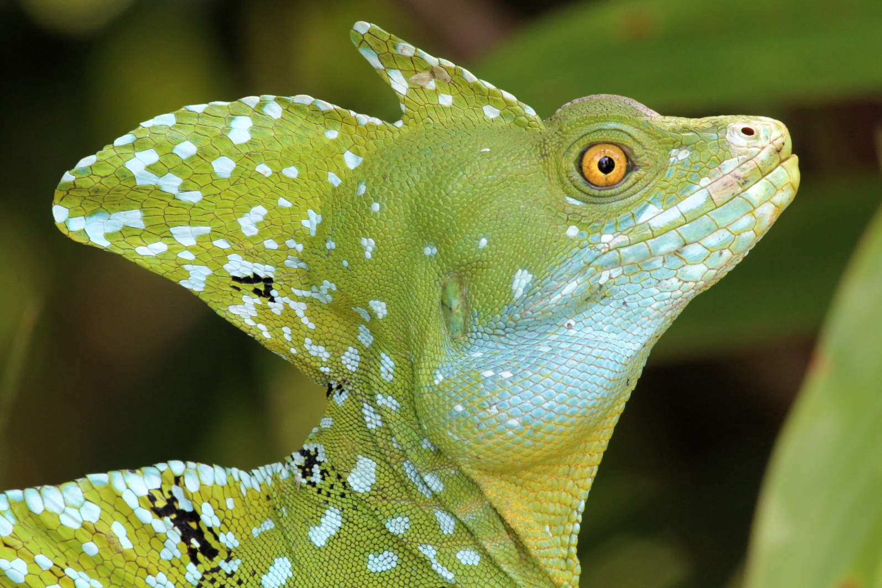
An overview of the changes in GCSE and A level Biology – and evaluating those changes

Slide 2
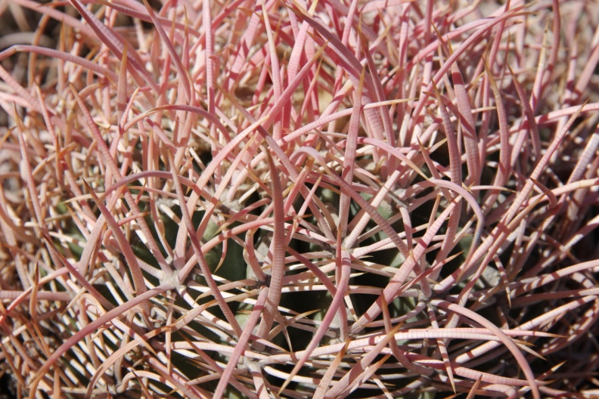
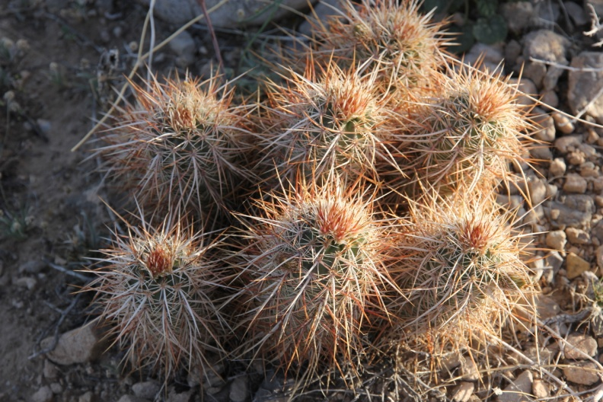

What has happened at GCSE?
Single exam at the end of 2 years
More synoptic approach
Fuller, more detailed GCSE criteria
Increase in maths requirements
Change in practical requirements and assessment
Changed assessment model

Slide 3
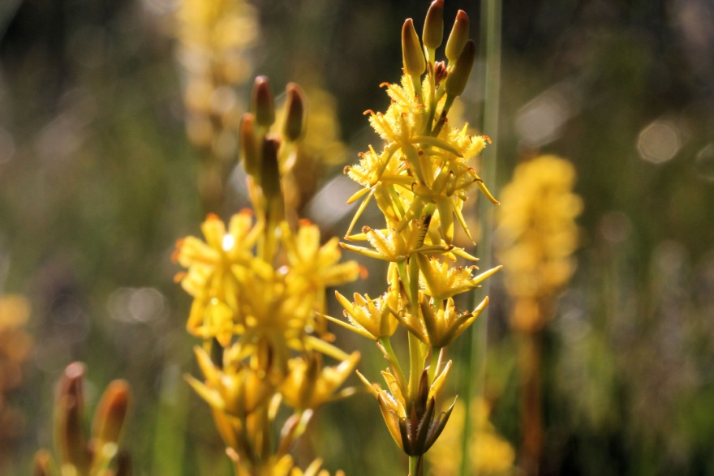
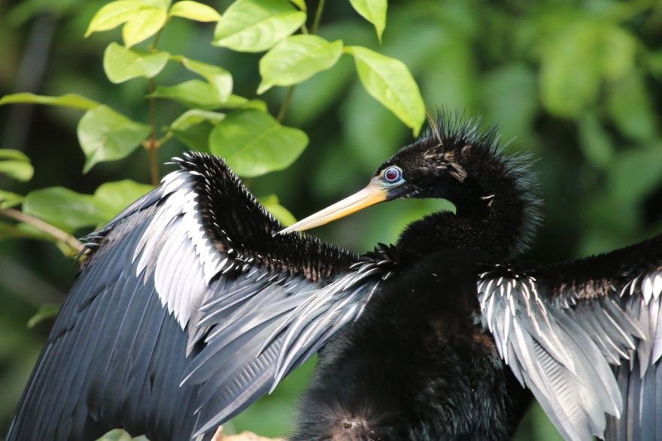
GCSE content revision
Contemporary content
Better coverage of ‘biology for life’
Improved balance including more on plants and microorganisms
Stronger reflection of biology issues
Good progression from new Key Stage 3 Science curriculum
Good preparation for A level Biology

Slide 4
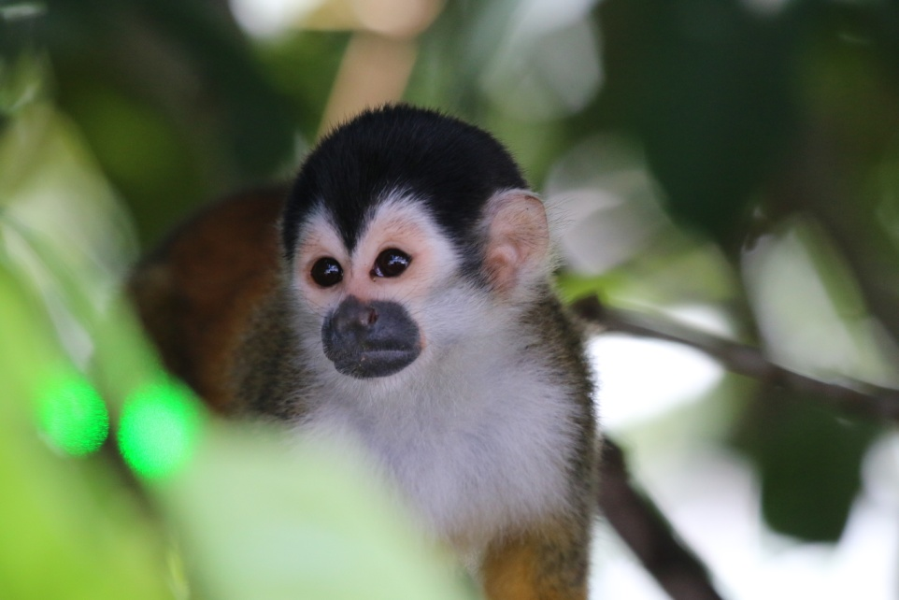
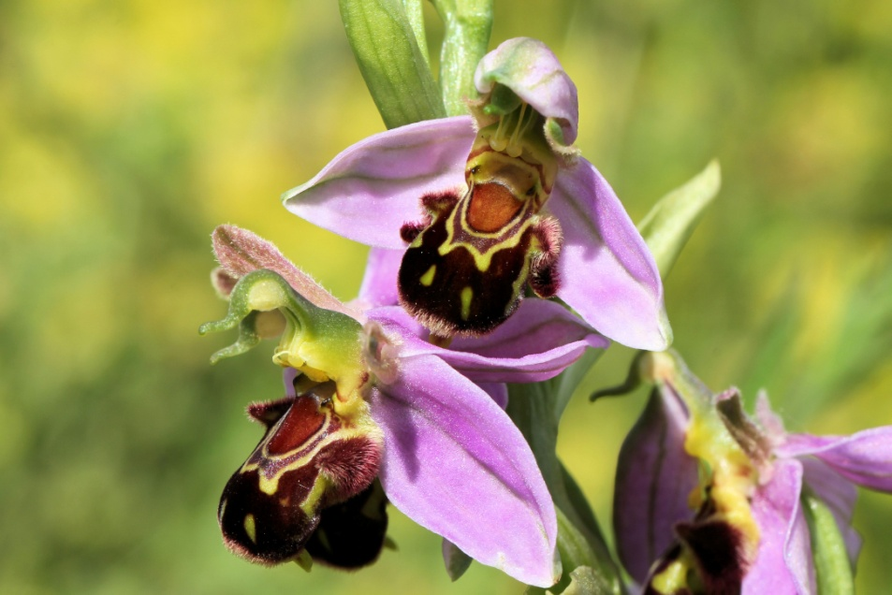
Looking to the future
The curriculum, GCSEs and A levels WILL change again
Governments tend to
be in a hurry
Preparation is key
Marry idealism with realism and pragmatism
Evaluation and evidence

Slide 5
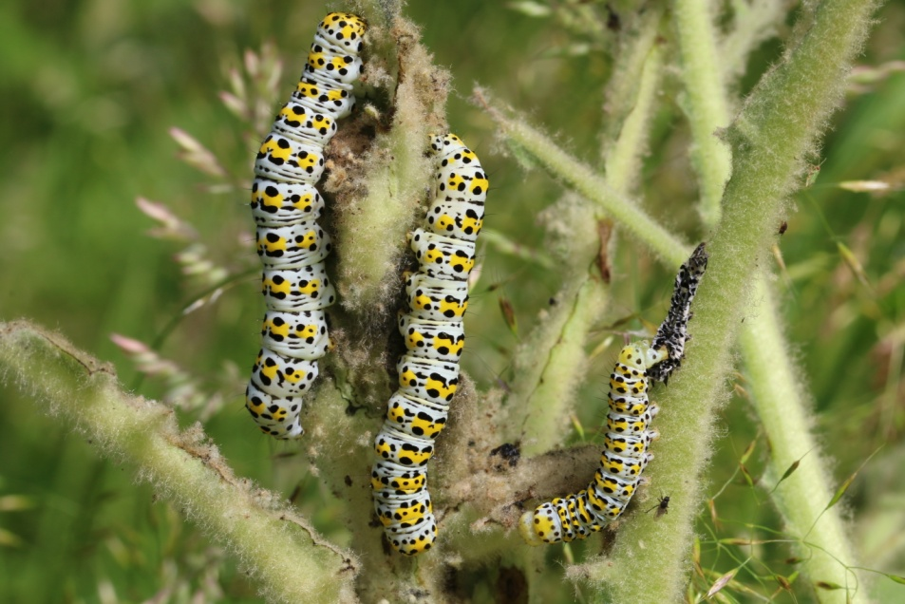
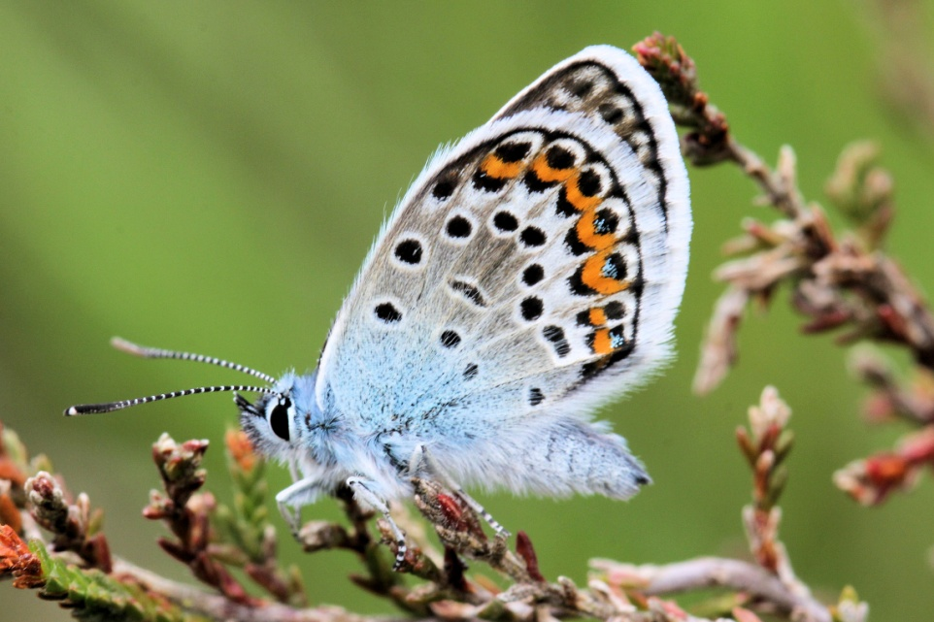
Some key moments of change
2015 – first cohort old GCSEs/new A levels
2016 – final cohort old GCSE/old A level to university
first cohort new GCSEs
2017 – first cohort old GCSE/new A level reach university
2018 - first cohort make transition from new GCSEs to new A levels
2020 – first cohort new GCSEs and new A levels reach university

Slide 6
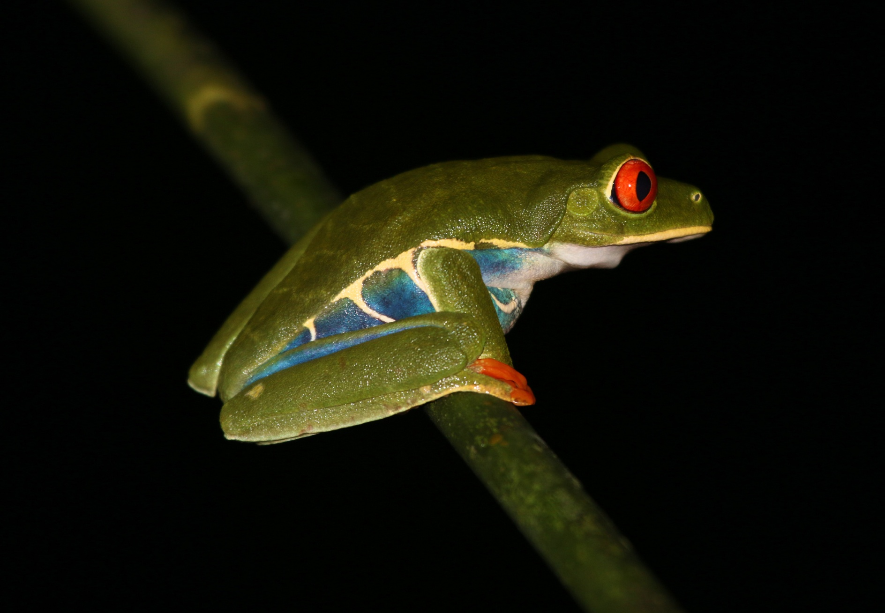
Over to you!

Slide 7
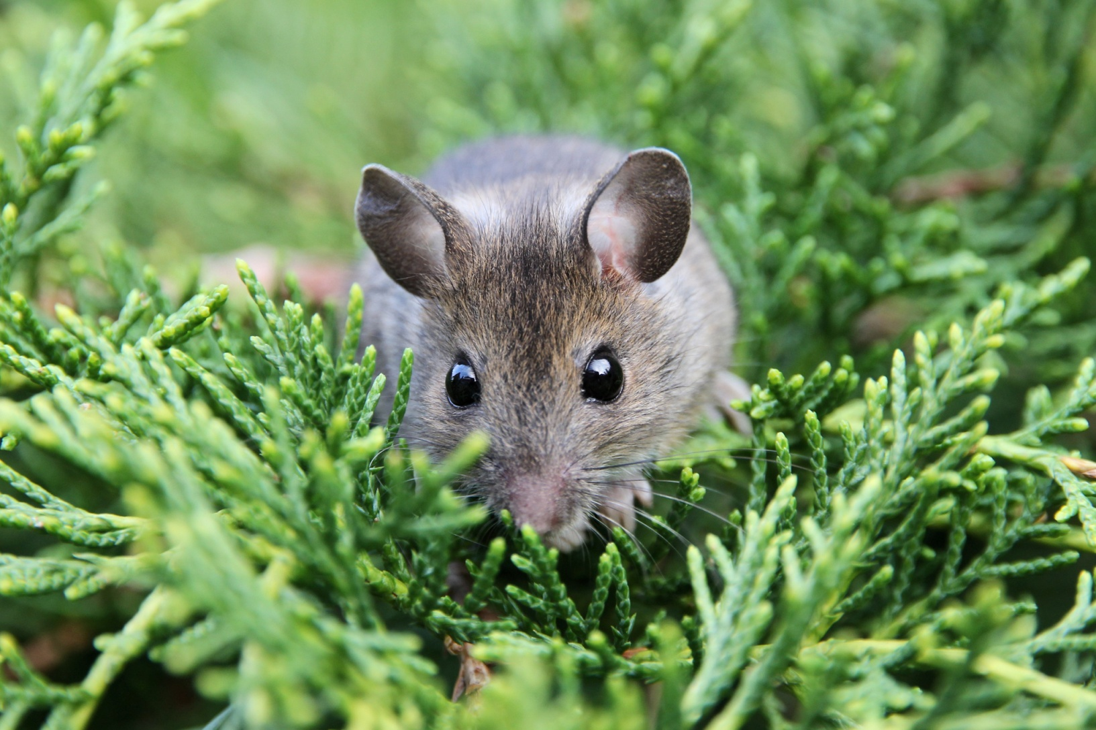
Thank you for listening

